Slide 1
Facilitating value generation from biotechnological research and development
Special Adviser Steinar Bergseth (Ph.D.)
Digital Salmon Industry Workshop
Thon hotell, Ski. 5.-6. june 2019

Slide 2
Content
1
Digital biotechnology
6
Summing up
2
The value chain
3
Examples
4
Tools & funding
5
Data sharing

Slide 3
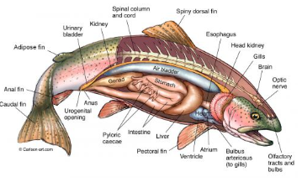
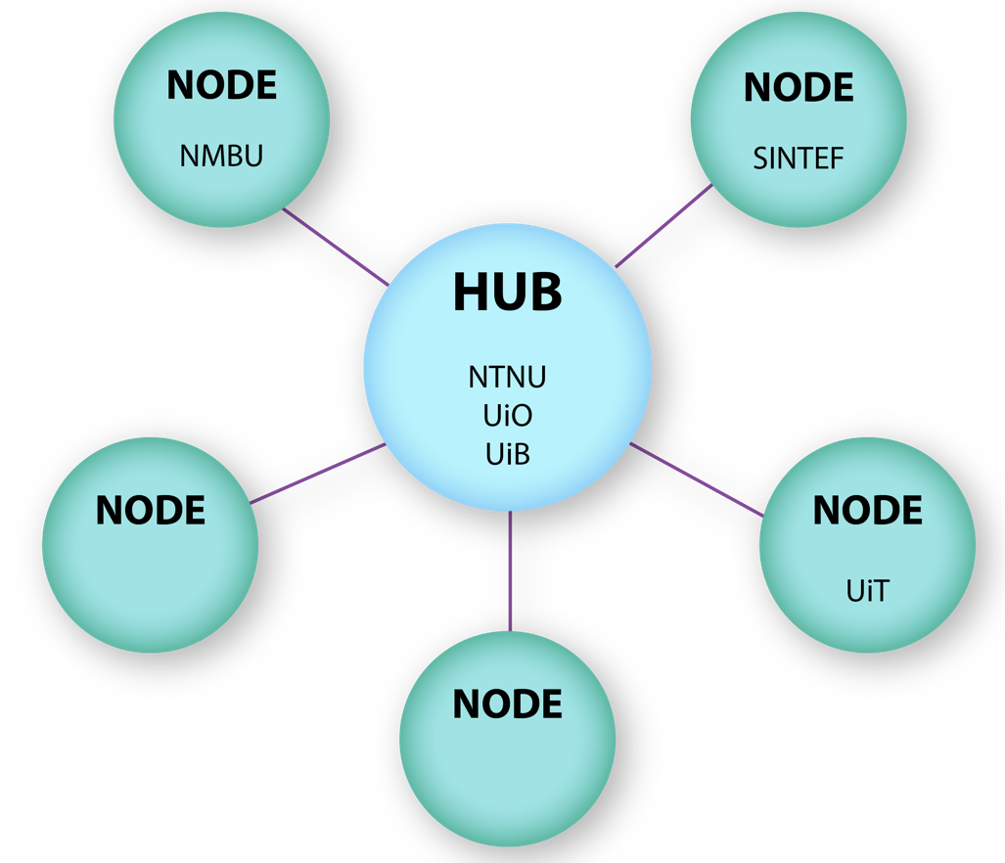
Digital Life Norway & Digital Salmon
DLN
DS
A project under the Biotechnology program (BIOTEK2021) until mid 2021
  An evaluation process ongoing
  An innovation project ongoing
An unique transdisciplinary research centre creating the biotechnology for tomorrow. Our aim is to evolve new knowledge and methods to create value and address societal challenges.
  Mathematical modelling, systems approach
Established 2015 as a Hub node structure with R&D projects and 6 generic workgroups
https://digitallifenorway.org/gb/
3 calls for R&D proposals lead
by scientists with industry
involvement
One of the >20 projects
Integrating modelling, mathematics,informatics genomics and experimental biology
Strong aim for industrial involvement and uptake
  Two industrial partners
Vision...?

Slide 4


Acadmics → Industry: A common strategy and coordination based on societal anchoring
Technology push
Basic
research
Identify possibilities
Validate technology
Develop products
Sale & marketing
Market pull
Research infrastructure
Pilotplants & uppscaling
Incubators
Notes:
4

Slide 5

Learn from...
The Atlantic salmon genome sequencing
  Financed through a Canada, Chile, Norway collaboration
  Industry financing and precompetitive insights
  Ministries funding
  A 10 mUSD project over 10ish years
National seaweed platform for R&D with industry participation
  A collaborative effort between the BIOTEK2021 & Aquaculture programs
  A strong request for industrial involvement and national anchoring also institutional
  A 34 mNOK project over 5 years
The Earth Biogenome Project – sequence all eucaryotic organisms
  Norway as a node - a strong value creation perspective
  Ministries approached
  Institutions engaged and signed an agreement
  A plan in the making

Slide 6
The Reasearch Council & Innovation Norway
RCN
IN
Seven doors to the funding options
  https://www.forskningsradet.no/en/
  stb@rcn.no
A new Centre for research based innovations call in 2022 / 2023 (SFI)
  https://www.forskningsradet.no/en/about-the-research-council/programmes/sfi----sentre-for-forskningsdrevet-innovasjon/
Seed money available for networking in the initial phase
A partner in strategic networking, ministry and institutional involvement, etc...
Funding options within bioeconomy and innovation contracts
  https://www.innovasjonnorge.no/en/start-page/
Seed money available for networking in the initial phase
A partner in strategic networking, ministry and institutional involvement, etc...

Slide 7
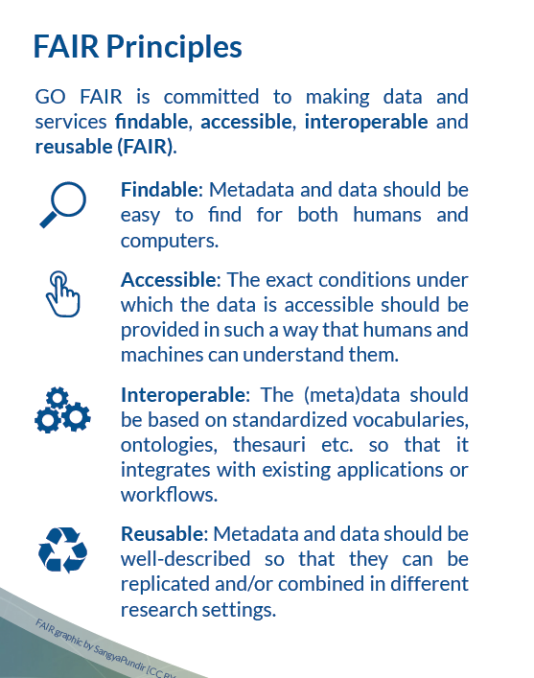
Forskningsrådets policy for åpen tilgang til forskningsdata (revidert i 2017)
Forskningsdata skal være så åpne som mulig, så lukkede som nødvendig; unntak for:
    data som må beskyttes av sikkerhetshensyn, personvern eller andre juridiske forhold
    data som skal benyttes kommersielt
    tilfeller der kostnaden ved tilgjengeliggjøring er høyere enn verdien av åpen tilgang
Data skal være «FAIR»:

Slide 8
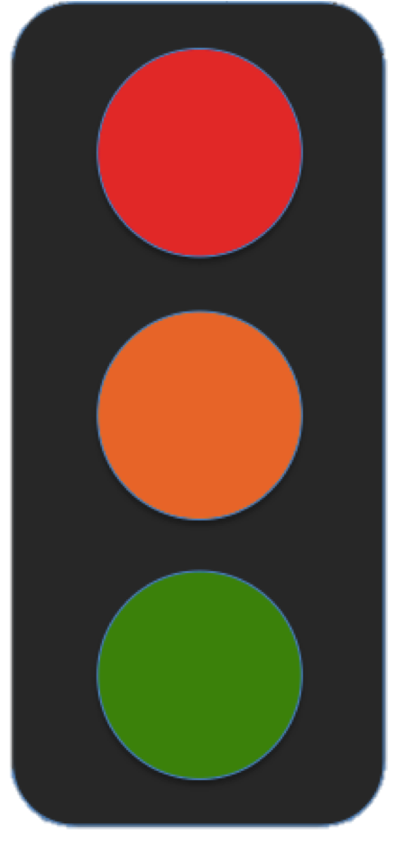
Sharing data
Several modes of sharing, e.g.:
Downloadable (raw data, processed data)
Searchable (e.g. online search interfaces)
Several degrees of access:
Open
Open w/authentication
Restricted (conditioned by users/use)
Closed (e.g. for privacy reasons)
+ embargo
Notes:
Should all data be shared openly?
No. But the fact that they exist should be public information.
When can data be shared?
Typically in connection with publications, or at the end of the project (embargo if necessary).
Under which conditions & with whom?
As open as possible, as closed as necessary.
Can others find, understand and use my data?
Yes. With proper documentation and long-term curation.
When archiving your data at NSD, you as a researcher decides in line with NUPIs policy, which degree of access yorr data will have.
Open: Data is open to all and can be downloaded directly from NSD. NSD can not log who downloads data. –
Open (Authentication): Data is open to everyone at login and can be downloaded directly from NSD. NSD can log who downloads data and secure version control. This is important as more depositors need to get information about use for reporting.
Restricted: Data is only available to selected actors.
Closed: Data is initially unavailable. All data will have a license that is independent of the access level.

Slide 9
Summing up...
Appoint a lead with access to a secretarial function
Sign a MoU to commit your friends - including the institutions
Make good consortium agreements regarding IPR, but regard precompetitvie knowledge as the most valuable asset. Respect different needs for IP protection, but work for openess.
Listen to the silver team, but even more to the young...
(Do) FHF has a role(?)
Create value while building the digital salmon

