Slide 1
Publishing FAIR studies with citable research assets: a case study
Modelling glucose metabolism in malaria patients
Jacky Snoep, Stellenbosch University
ISA, Combine-archives, publishing
Notes:
REUSE flavour
FAIRDOM - FAIR asset management and sharing experiences in Systems Biology
Over the past 5 years we have seen a change in expectations for the management of all the outcomes of research – that is the “assets” of data, models, codes, SOPs and so forth. Don’t stop reading. Yes, data management isn’t likely to win anyone a Nobel prize. But publications should be supported and accompanied by data, methods, procedures, etc. to assure reproducibility of results. Funding agencies expect data (and increasingly software) management retention and access plans as part of the proposal process for projects to be funded. Journals are raising their expectations of the availability of data and codes for pre- and post- publication. The multi-component, multi-disciplinary nature of Systems Biology demands the interlinking and exchange of assets and the systematic recording of metadata for their interpretation. The FAIRDOM (Findable, Accessible, Interoperable, Reusable Data, Operations and Models) Initiative has 8 years of experience of asset sharing and data infrastructure ranging across European programmes (SysMO and EraSysAPP ERANets), national initiatives (de.NBI, German Virtual Liver Network, UK SynBio centres) and PI's labs . It aims to support Systems Biology researchers with data and model management, with an emphasis on standards smuggled in by stealth and sensitivity to asset sharing and credit anxiety. This talk will use the FAIRDOM Initiative to discuss the FAIR management of data, SOPs, and models for Sys Bio, highlighting the challenges of and approaches to sharing, credit, citation and asset infrastructures in practice. I'll also highlight recent experiments in affecting sharing using behavioural interventions. http://www.fair-dom.org http://www.fairdomhub.org http://www.seek4science.org

Slide 2
SEEK data structures; ISA and beyond
Programme SARCHI: Mechanistic modelling of health and epidemiology
Projects 1) Modelling glucose metabolism in malaria patients; 2) TB; 3) HIV; 4) T2D
Investigations 1a) Glucose metabolism in P. falciparum trophozoites; 1b); 1c); 1d;
Study i) Model construction; ii) Model validation; iii) Model analysis;
Assay 19; Data files 13; Models 13; SOPS 12;

Slide 3
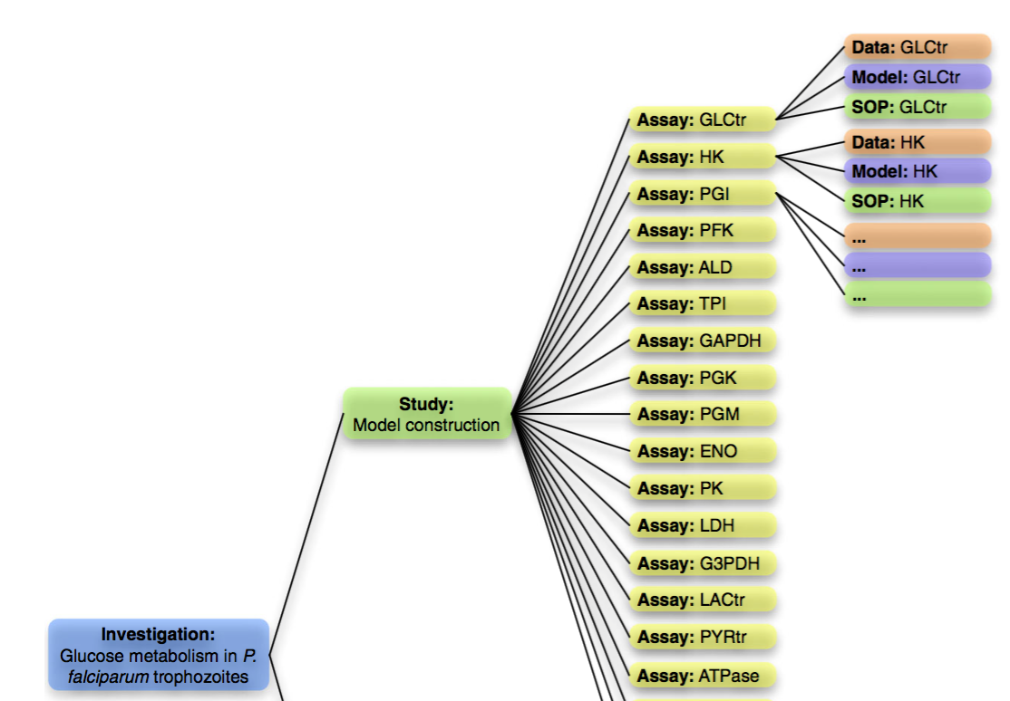
SEEK data structures; ISA and beyond

Slide 4
SEEK data structures; ISA and beyond
Local SEEK for all data/model files;
FAIRDOMHub for all published data/model files
RightField annotated Excel files for data
SBML for mathematical model files; Mathematica for direct analysis notebooks; Word for SOPs
SBML model can directly be annotated in JWS; editable SBGN schema generated
DOIs can be generated for individual assets or grouped assets in SEEK

Slide 5
Combine archive simulation specs
Model analyses often lead to a simulation result; could be a publication figure
Important to be able to reproduce model analyses; Combine archive (SED-ML)
Can be linked directly to model analysis in SEEK: SED-ML archive link

Slide 6
Fairdom and Publishing
Data/models/SOPs are structured in ISA
Tools in SEEK, make it easier to adhere to standards (data in RightField annotated spreadsheets; models in MIRIAM annotated SBML files)
SEEK replaces messy Supplementary Info
Models directly simulatable in SEEK (via JWS), simulation scripts and data linking in SED-ML

Slide 7
Fairdom and Publishing
Collaborate with journals in peer reviewing manuscripts with mathematical models
Models undergo technical curation (contacting authors is often necessary)
Models are made available to reviewers (private), include links to SED-ML archives to reproduce specific figures in manuscript
After publication links are made available in the PDF, as clickable figures

Slide 8
Fairdom and Publishing

Slide 9
Acknowledgements
Fairdom team
JWS Online team
SARCHI (DST/NRF South Africa)
BBSRC

