Slide 1


My.PAL history & experience
Dr.Maksim Zakhartsev
Plant Systems Biology
University Hohenheim
Stuttgart, Germany

Slide 2
The very beginning
2006, the beginning of SysMO initiative
11 projects + SysMO-DB

Slide 3
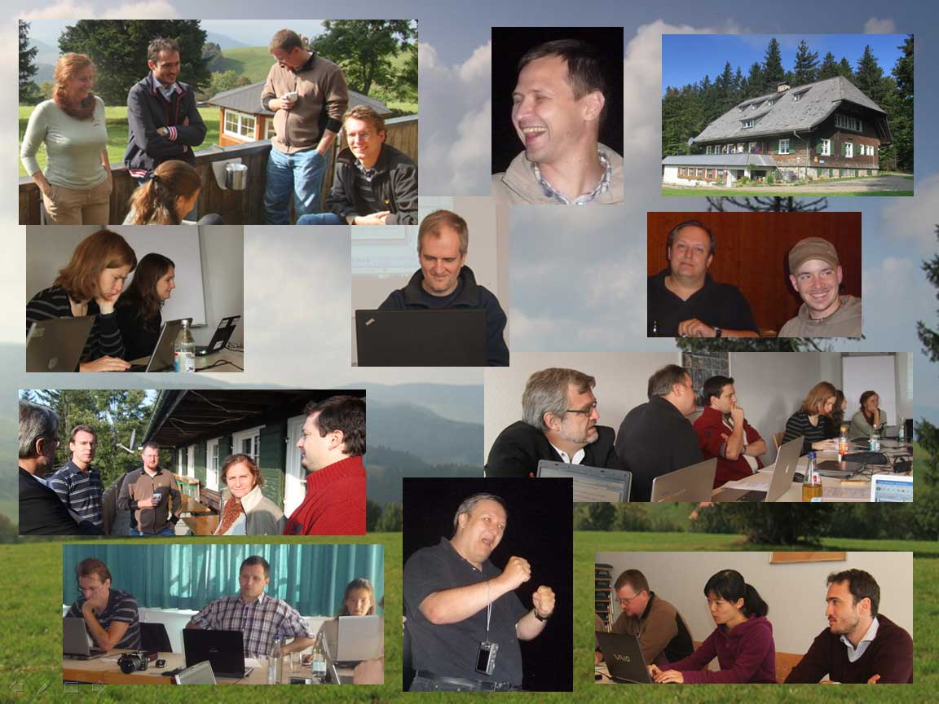
Who are the PALs?
Nominated project representatives for feedback contributions = PAL (Project Area Liaisons)
The PALs are a group of project representatives (e.g. experimentalists, modellers and bioinformaticians) who are the hubs among projects, software developers and DB.
http://fair-dom.org/communities/pals/pals-gallery/?hlst=PAL

Slide 4





Who are the PALs?
requirements gathering and consultation
reviewing of ideas and prototypes
testing and reporting on solutions
intelligence gathering from projects
Software developers
Project 1
PAL 1
PAL 2
Project 2

Slide 5
Advantages of fairdom-hub
Yellow pages
ISA – Investigation, Study, Assay stucture
Bundle of the assets and workflow
Sharing scientific research assets, processes and outcomes
Data storage and exchange
Data classification & management
Bundle storage of „project structure + SOP + exp.data + model + publications“
Supplementary material
Project management
Independent publication: DOI

Slide 6
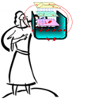
SysMO-MOSES
MOSES: MicroOrganism Systems Biology: Energy and Saccharomyces cerevisiae
ATP paradox
© Hans Westerhoff

Slide 7


Stimulus-response methodology
Continuous
steady state culture
D = 0.1 h⁻¹
T = 30°C
C^{feed}_{glucose} = 50 g/L
pO₂ = 0%
stimulus
response
Measurement of transient metabolite concentrations using perturbations of steady state conditions to make parameter estimation of the model
DATA file
ATP - paradox
Notes:
Stimulus-response experiment reveals unexpected system behavior, sometimes referred as ‘ATP-paradox’

Slide 8
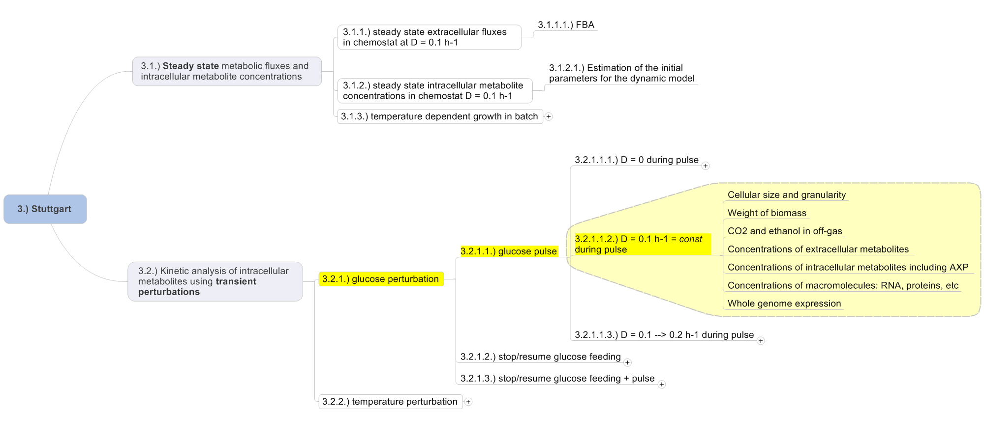
MOSES experiment classification

Slide 9
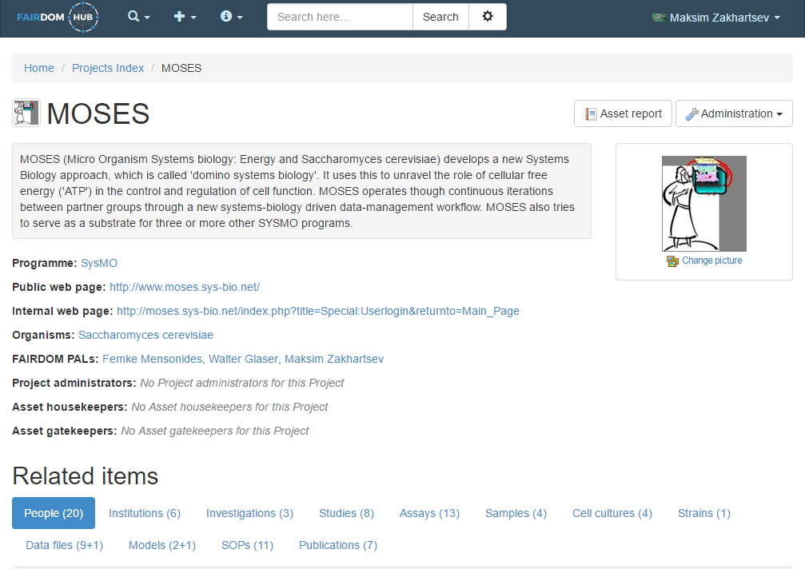

Slide 10
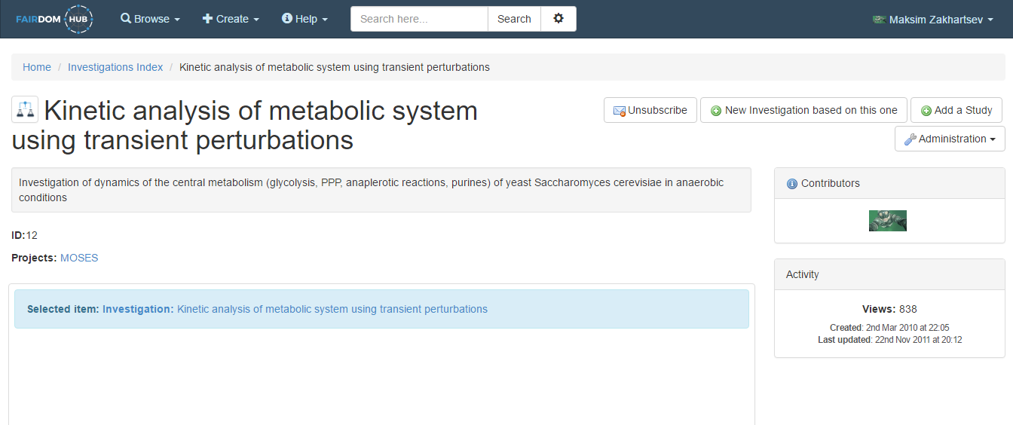
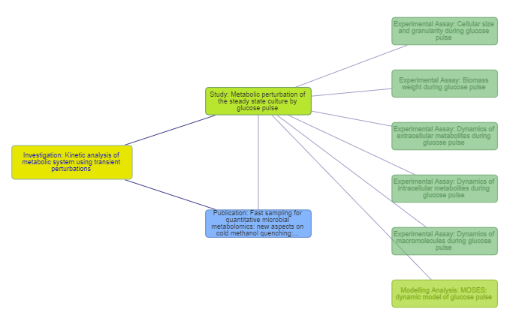
Experimental assay
Publication
Modeling assay
INVESTIGATION
STUDY
ASSAY

Slide 11
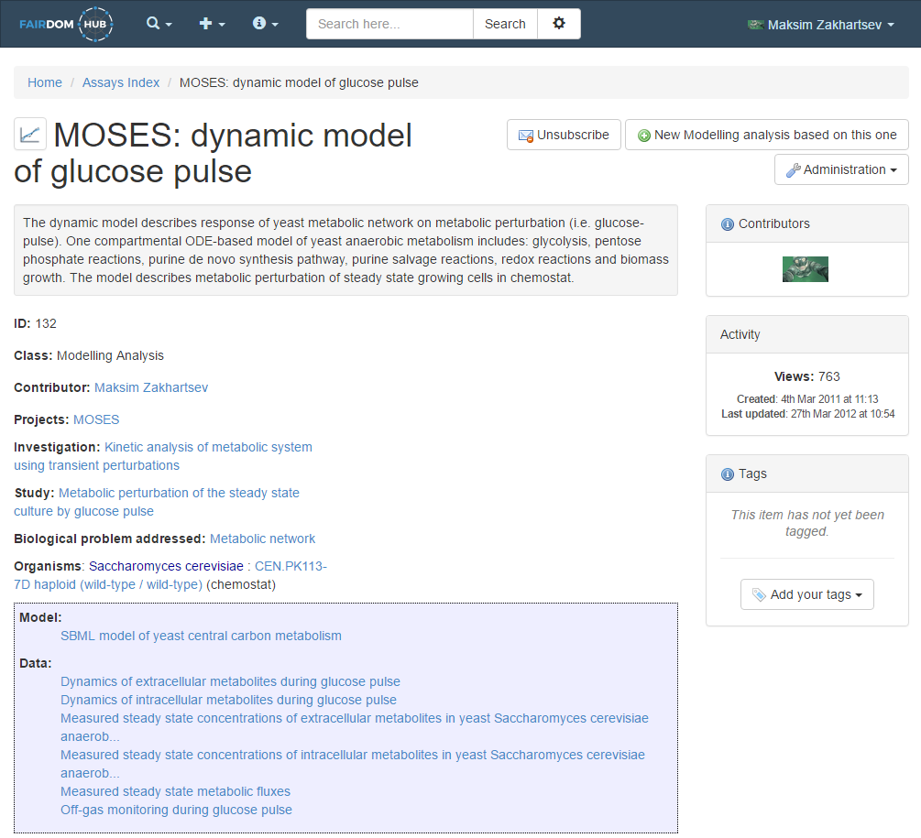
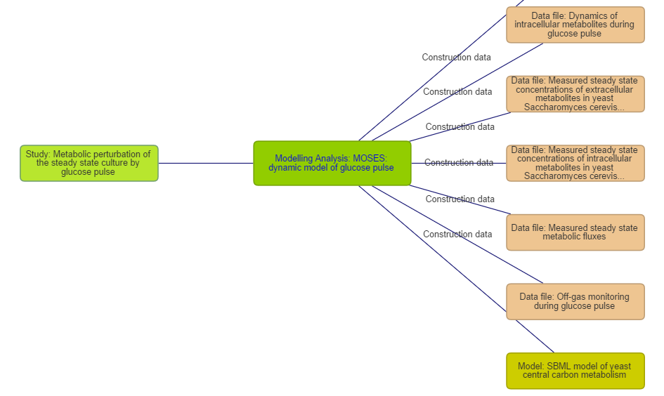

Slide 12

stoichiometric model
Stoichiometric model of Saccaromyces cerevisiae growing anaerobically at D=0.1 h¯¹
Compartments | 1
Pathways | 35
Transformers: | 254
reactions | 214
transports | 33
polymerization | 7
Compounds | 253
balanced comp. | 234
Notes:
Our research focus is on the interface among [glycolysis + PPP] and purine [salvage + ‘de novo’] pathways

Slide 13
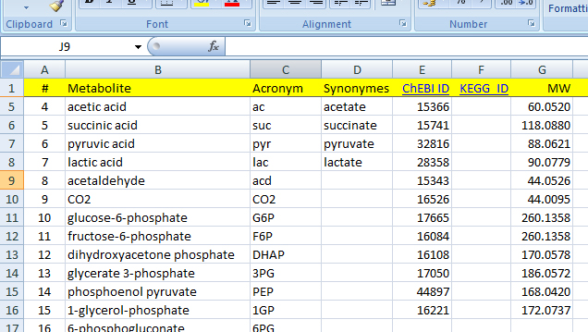
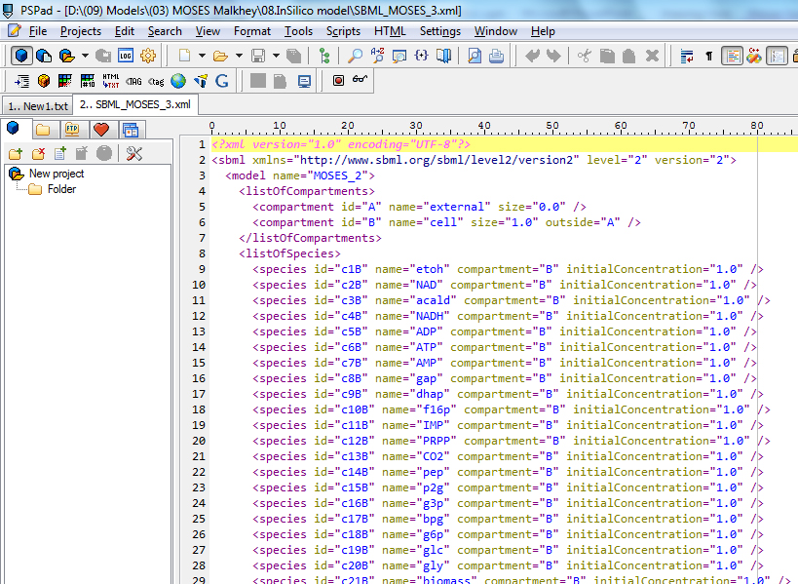
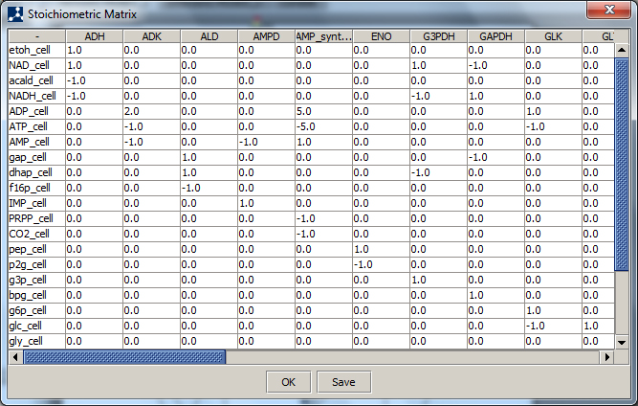
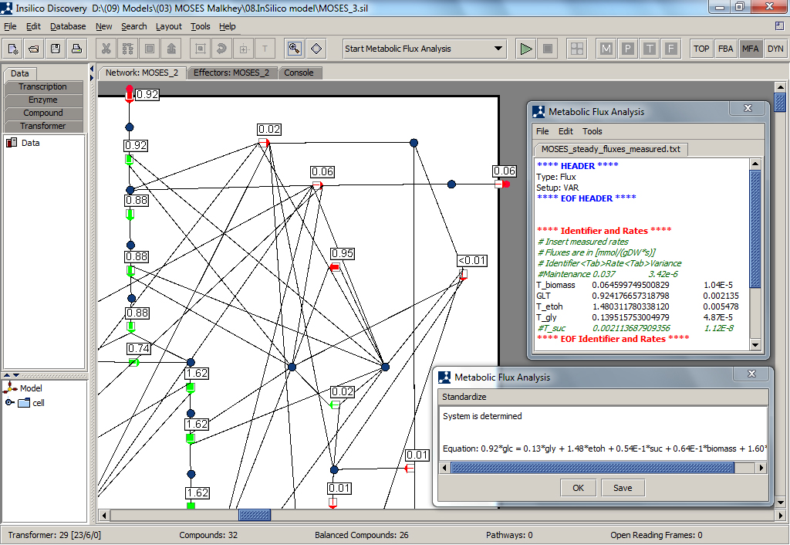

Supplementary information
SEEK
SEEK
SEEK
SEEK
Annotation
file
Stoichiometric
matrix
SBML
Stationary
fluxes

Slide 14

Model structure: mathematics

Slide 15
Model formulation

Slide 16

ODE-based model
example = glc-permease
DATA file
Equations
Simulations
variables: C^{ex}_{glc}, C_{glc}, C_{g6p}
parameters: R^{max}, K_{glc}, K_{I-g6p}, K_{II-g6p}
[Rizzi et al., 1997]

Slide 17





Model publication
exp.DATA files
SBML/MATLAB model
Model documentation
Pictures
Stoichiometric matrix
Compound database
Transformers database
MFA solutions
Publications
snapshot
reviewer

Slide 18
immortal fame
GlyCon
ZucAt
ExtremoPharm
StarPro

Slide 19











Acknowledgment
All IBVT colleagues and personally:
Dr. Alexei Lapin
Dr. Oliver Vielhauer
Achim Hauck and the rest IBVT support-team
All MOSES colleagues and personally:
Prof. Hans V. Westerhoff (Amsterdam/Manchester)
Prof. Stefan Wölfl (Heidelberg, Germany)
Prof. Peter Ruoff (Stavanger, Norway)
Dr. Malkhey Verma (Manchester)
We thank the SysMO funding organizations of five SysMO lands (BBSRC, BMBF, BMWF, NWO, RCN) for their financial support of MOSES.
Additionally:
Dr. Xuelian Yang (Nanjing University of Technology, China)
Dr. Christoph Hold (ETH, Zurich)

