Slide 1
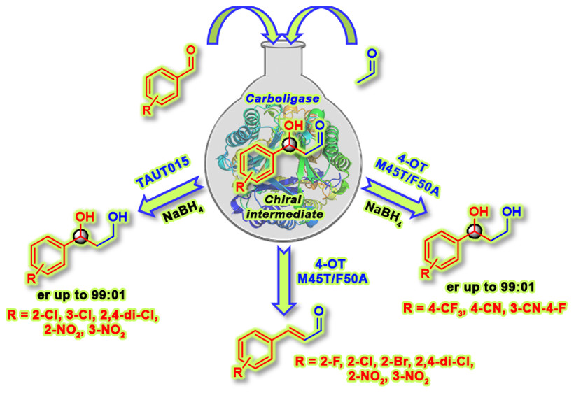
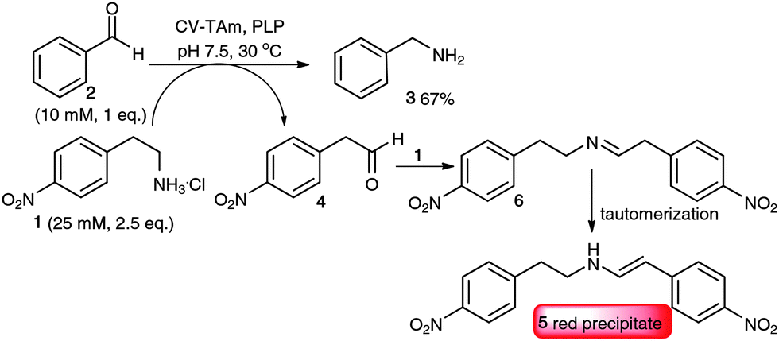
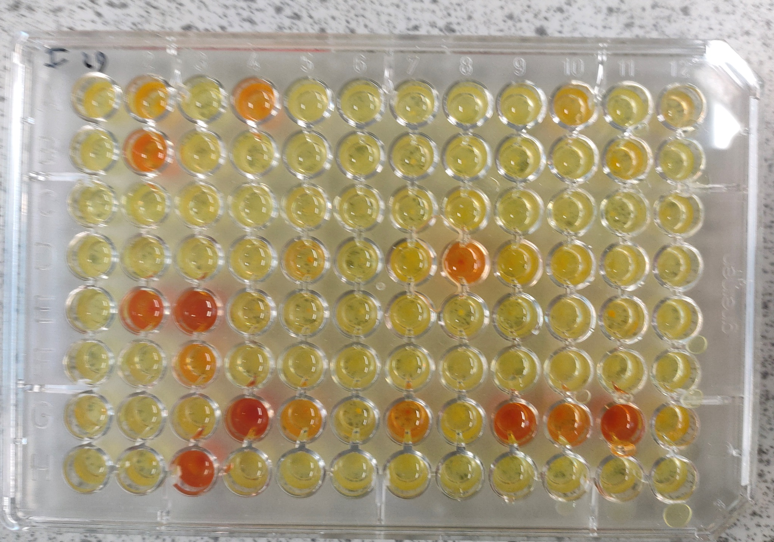
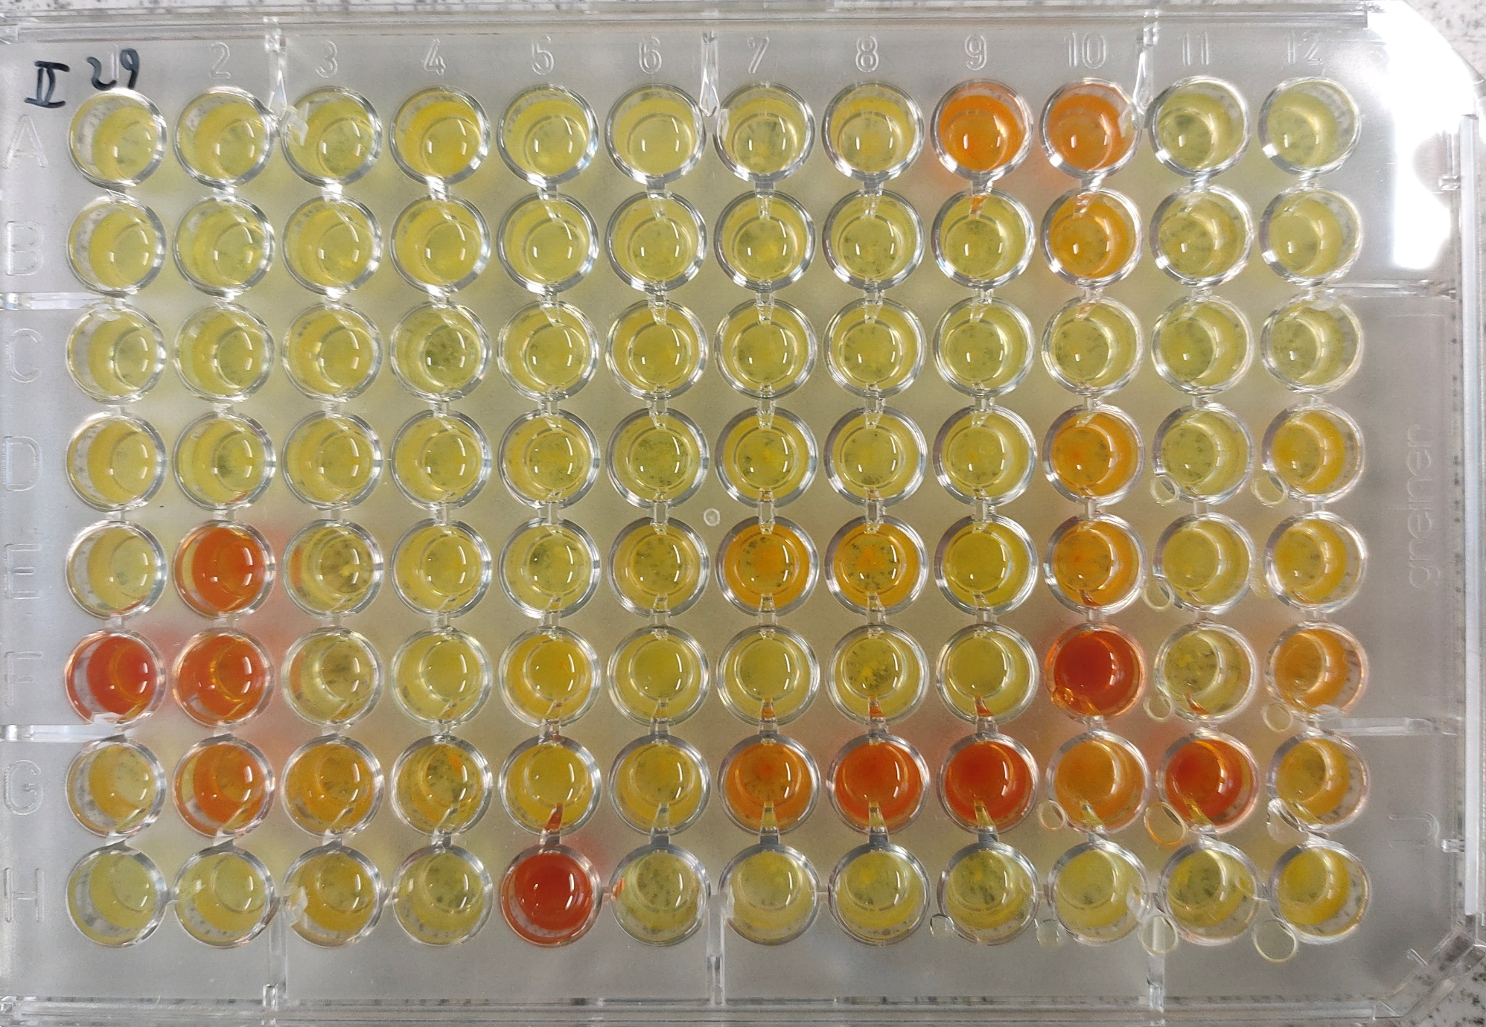
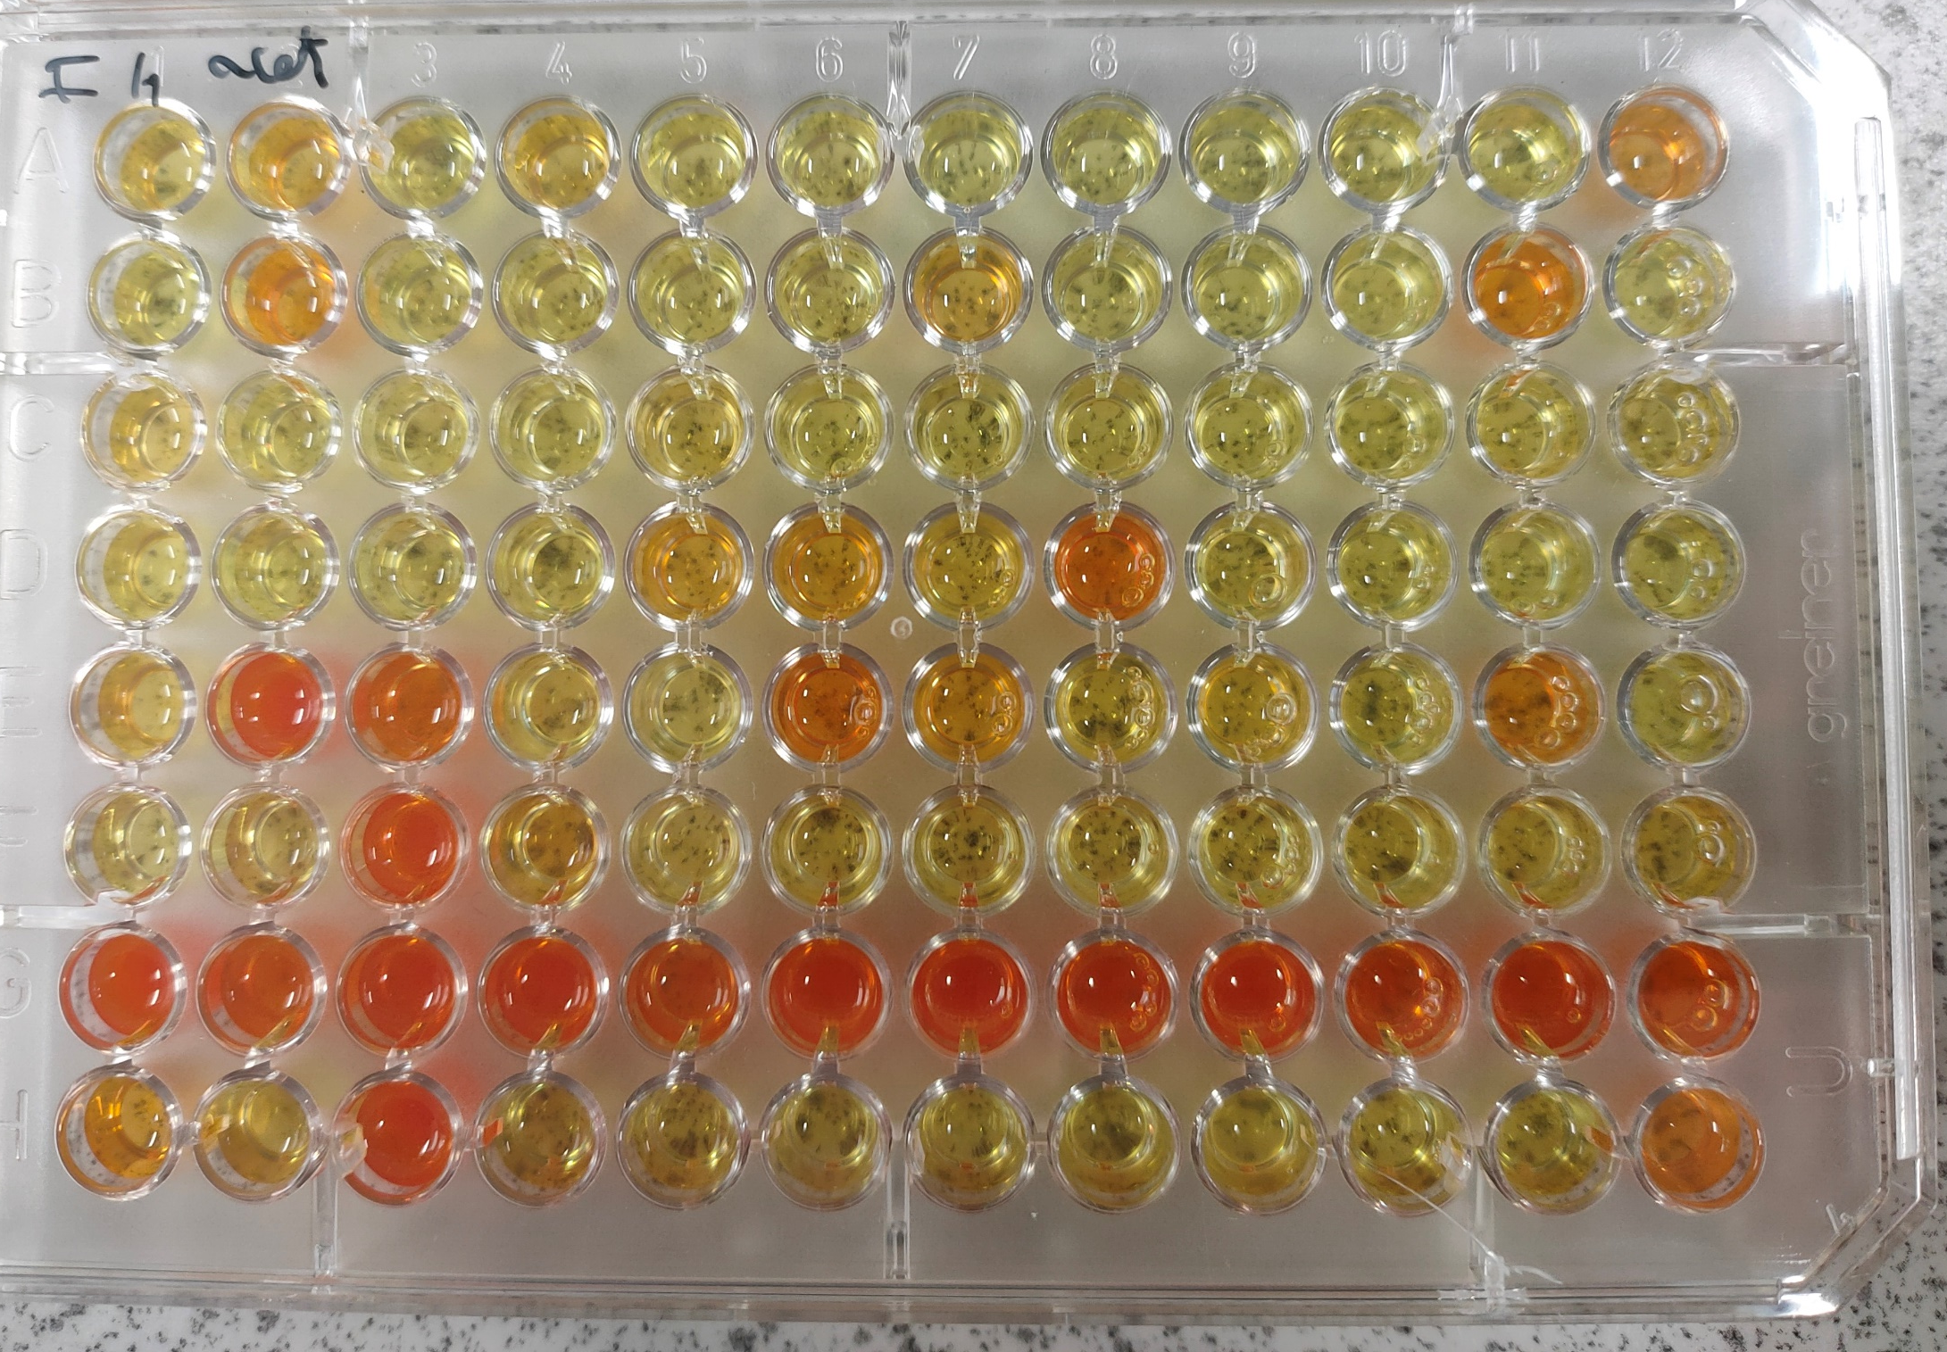
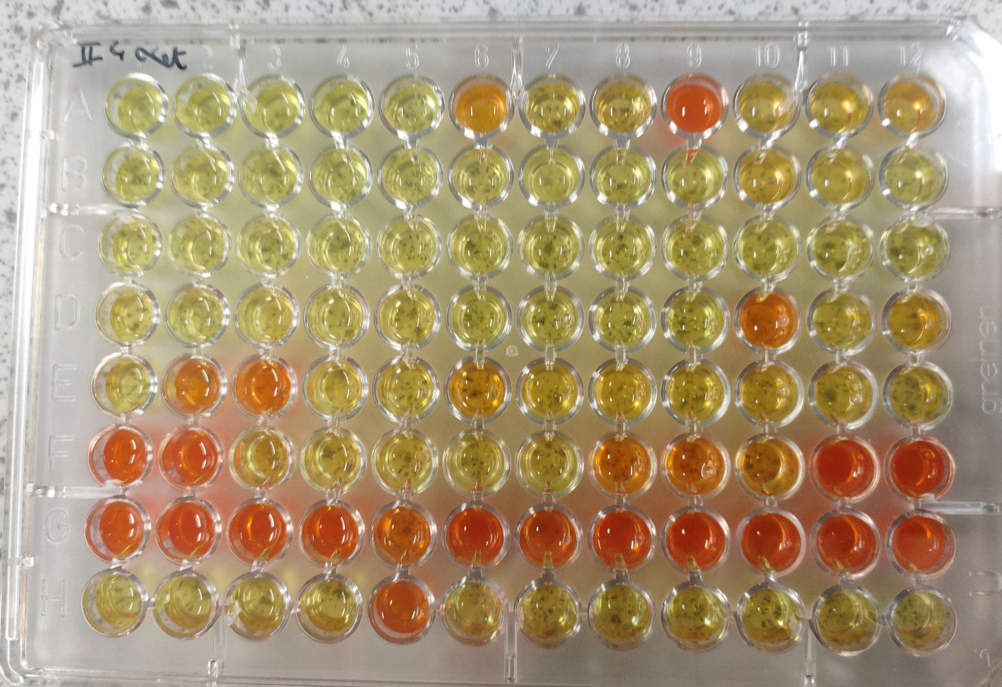
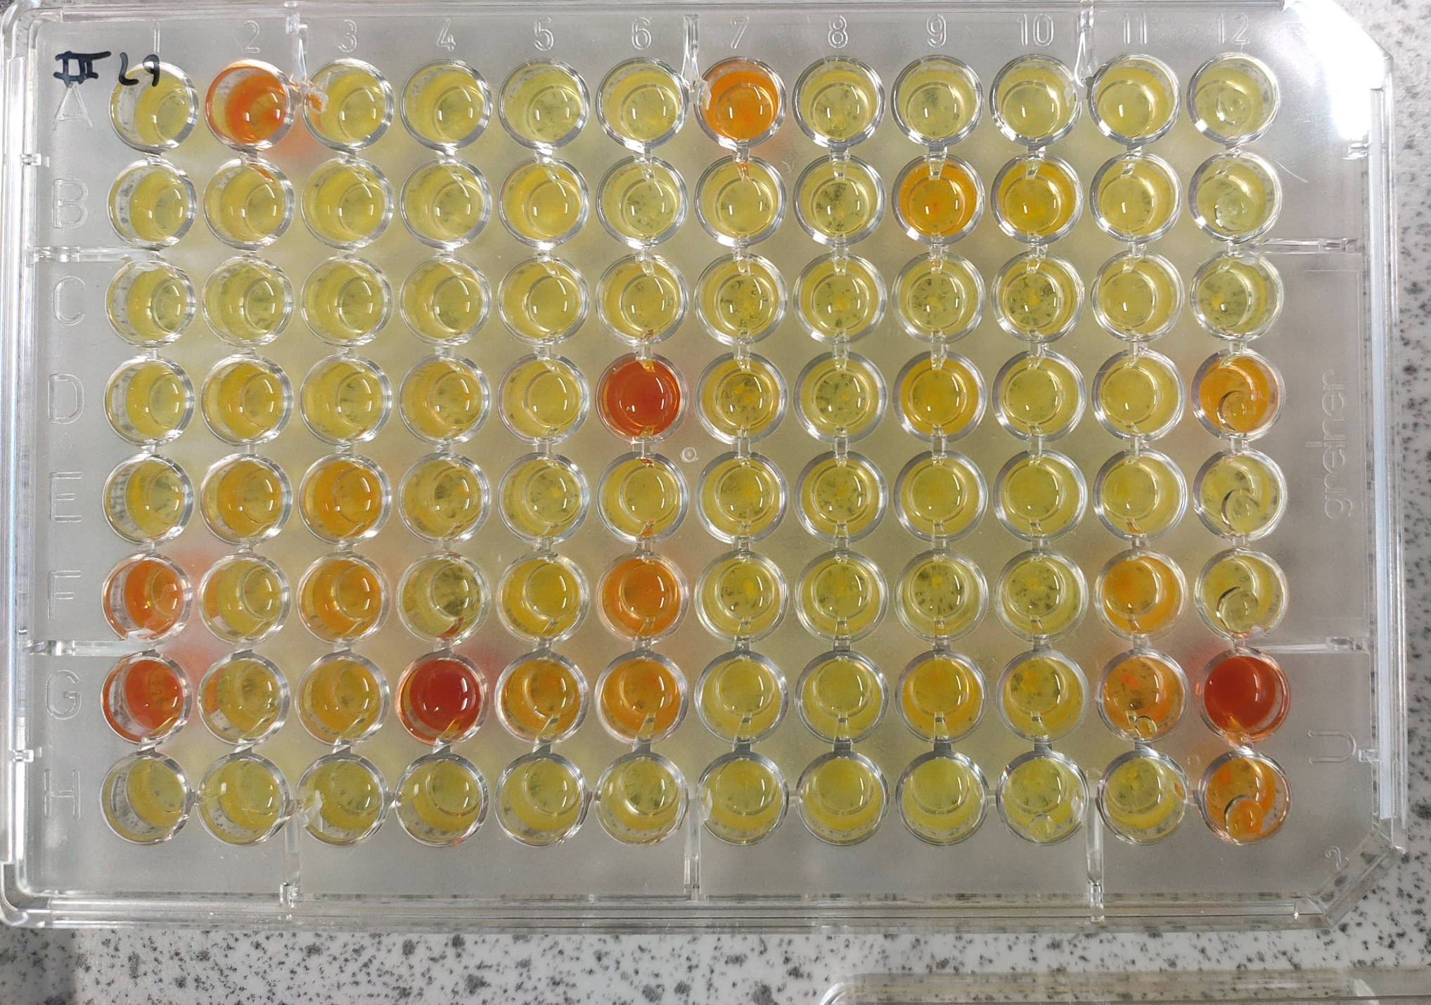
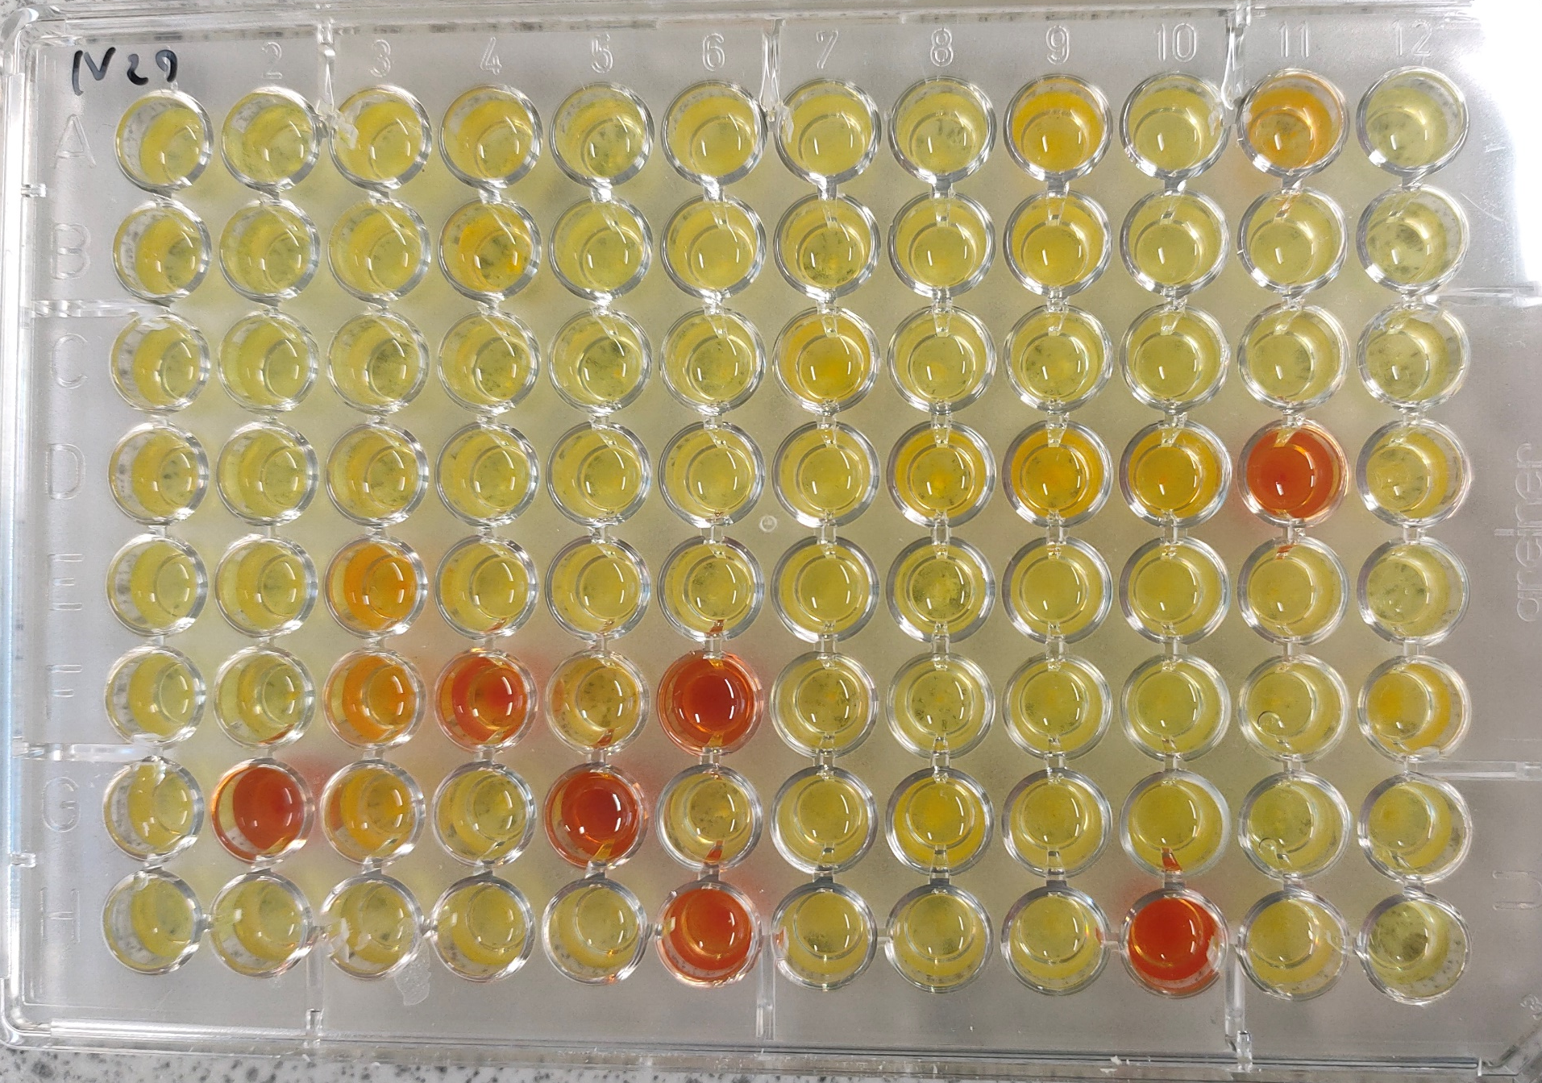
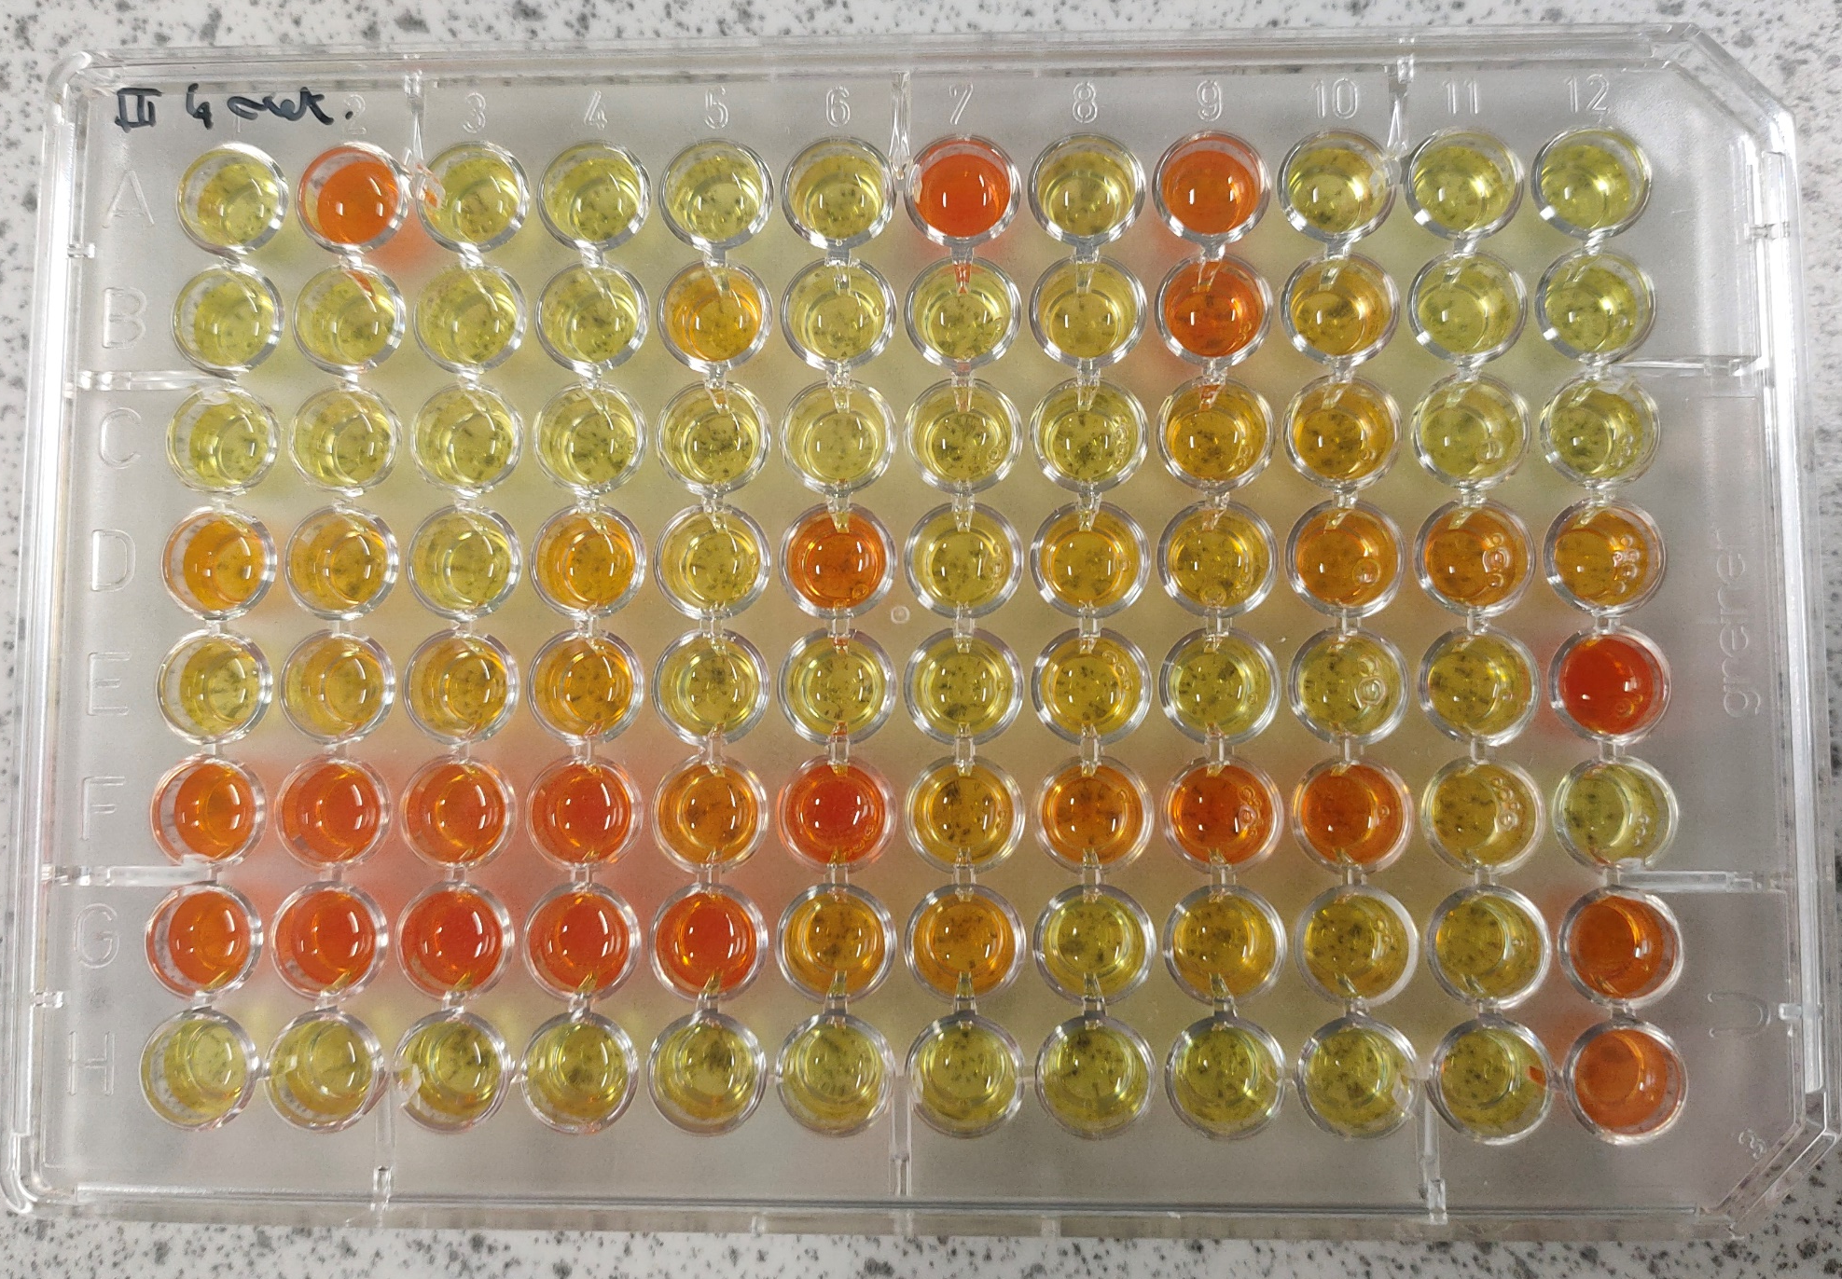
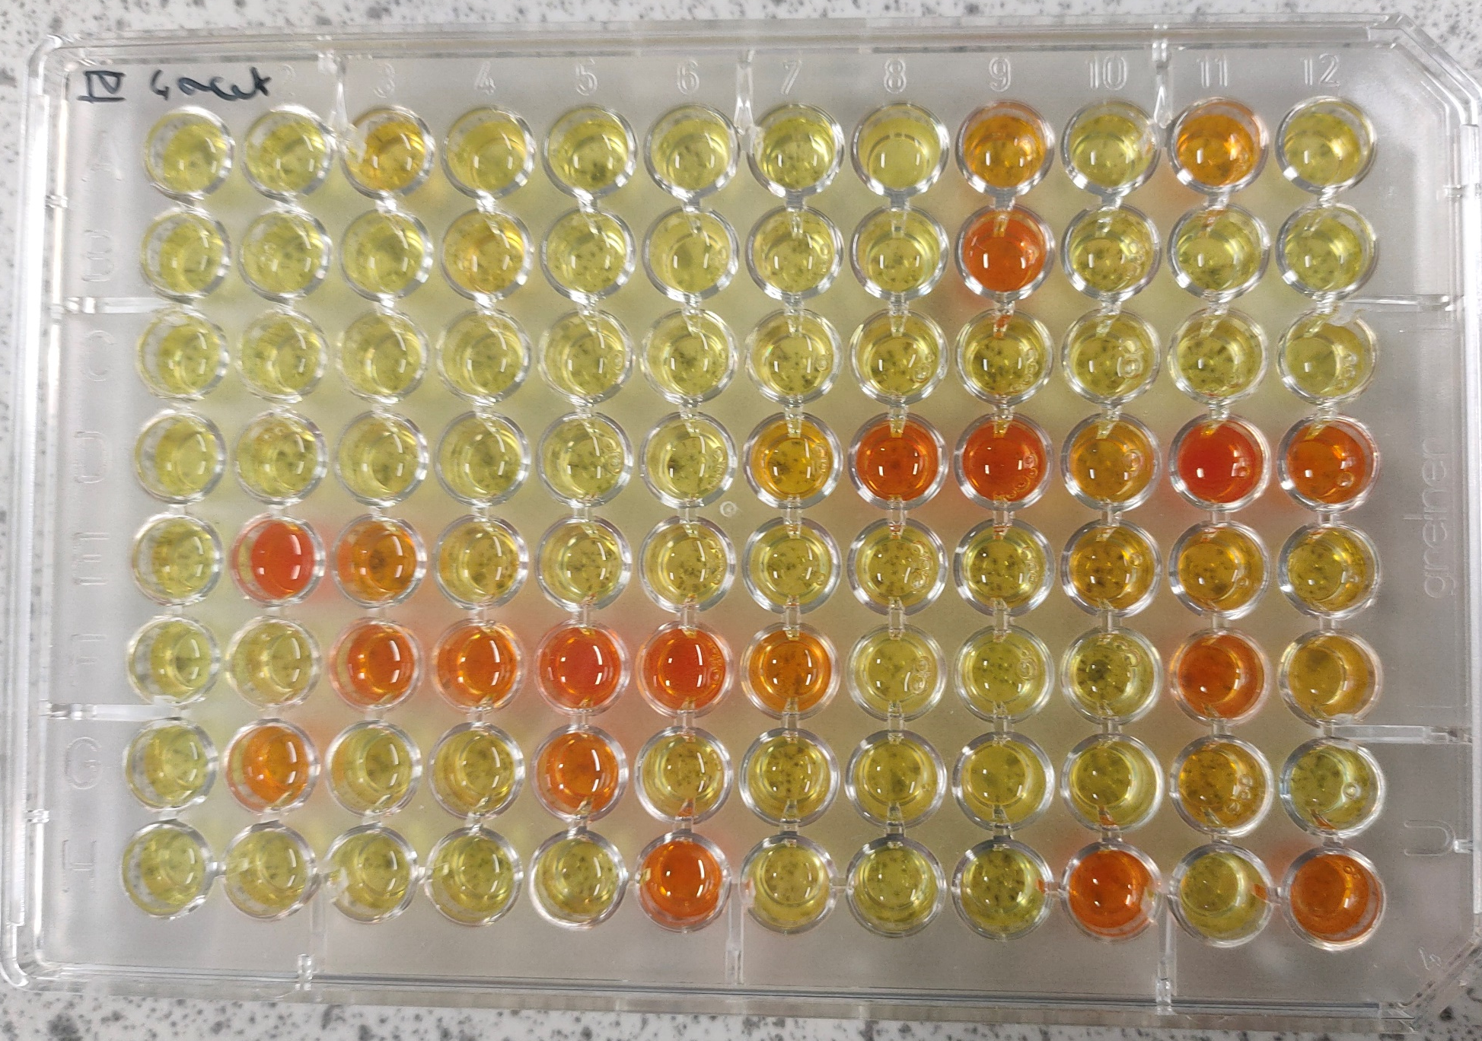
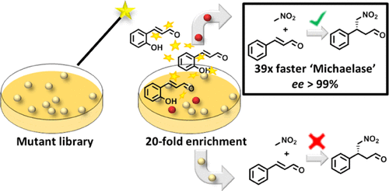
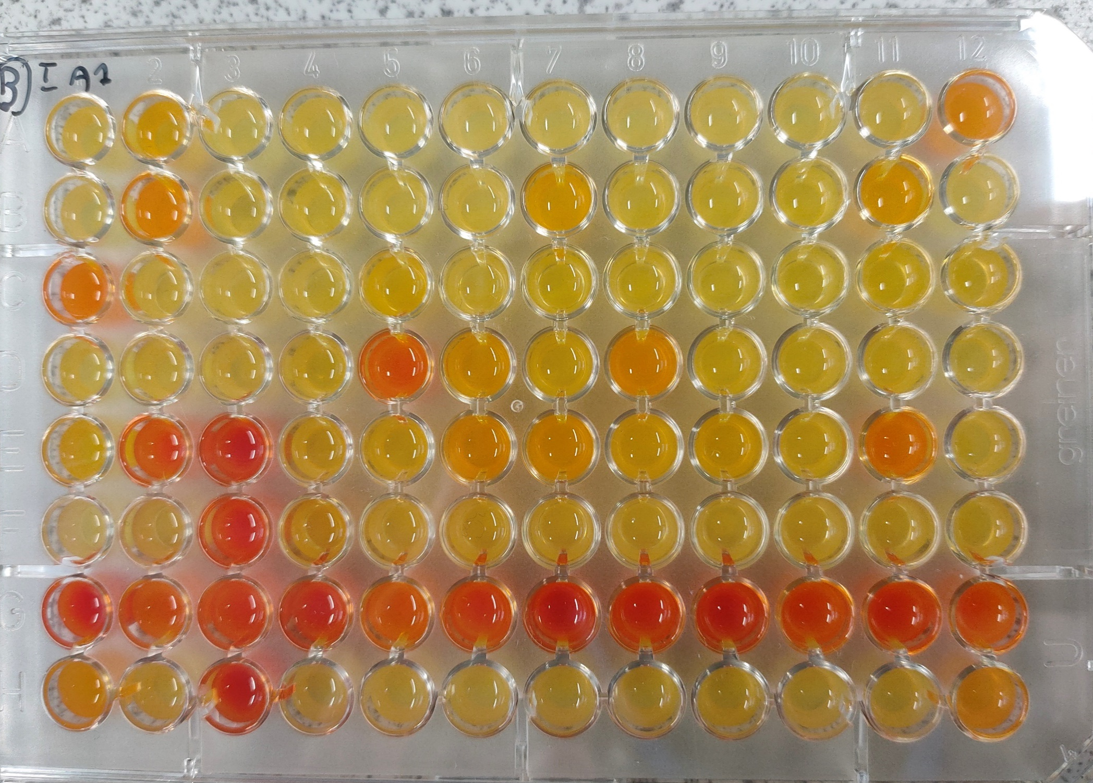
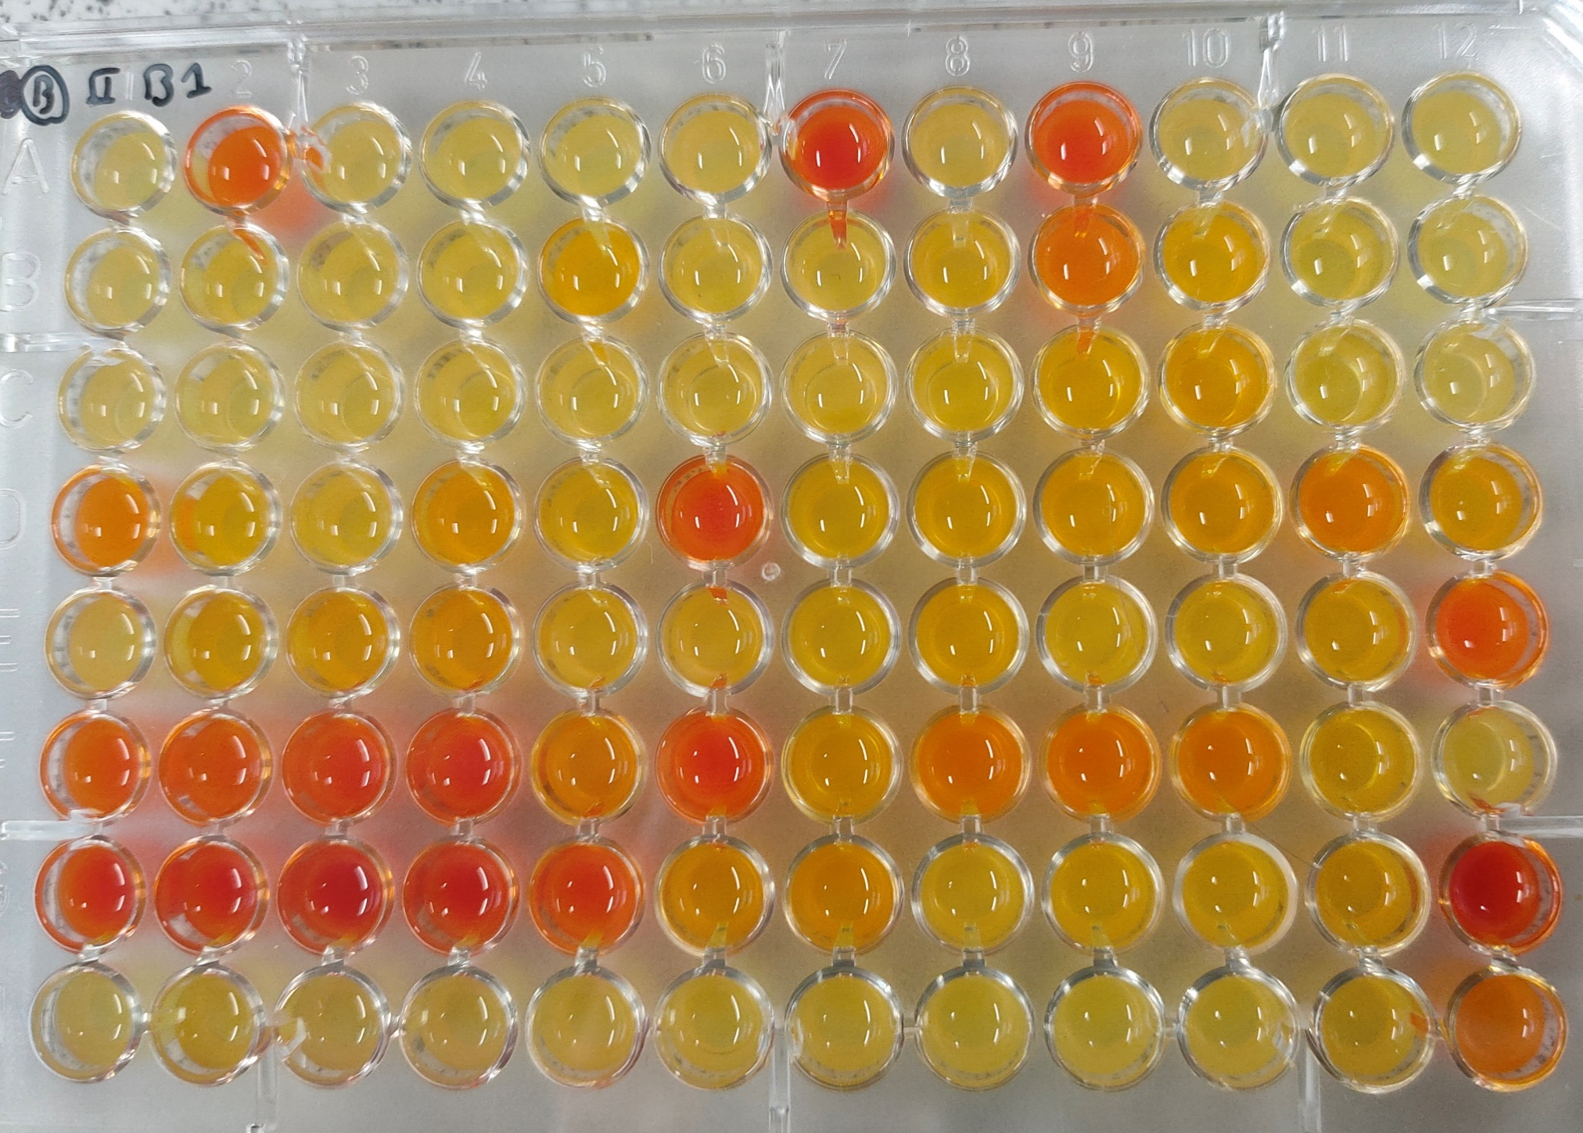
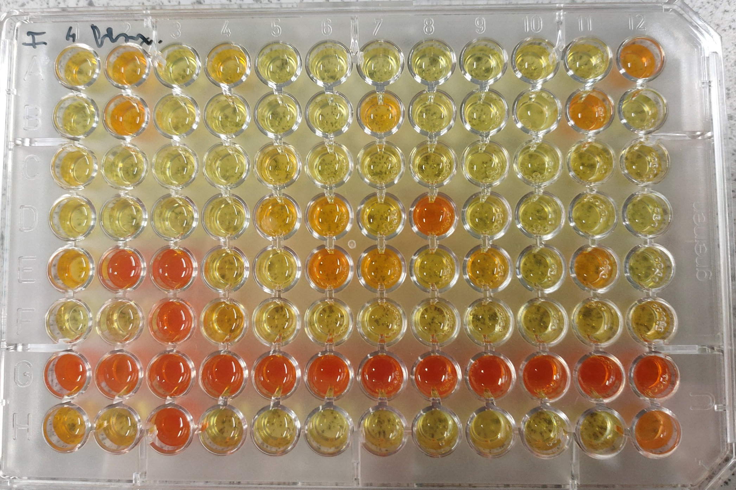
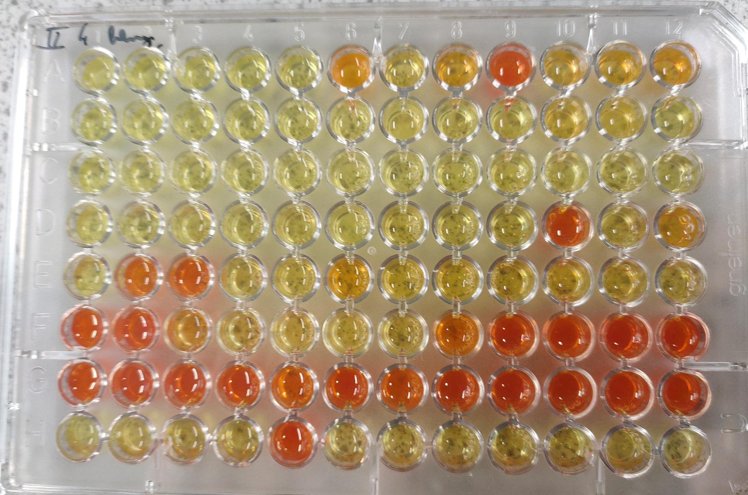
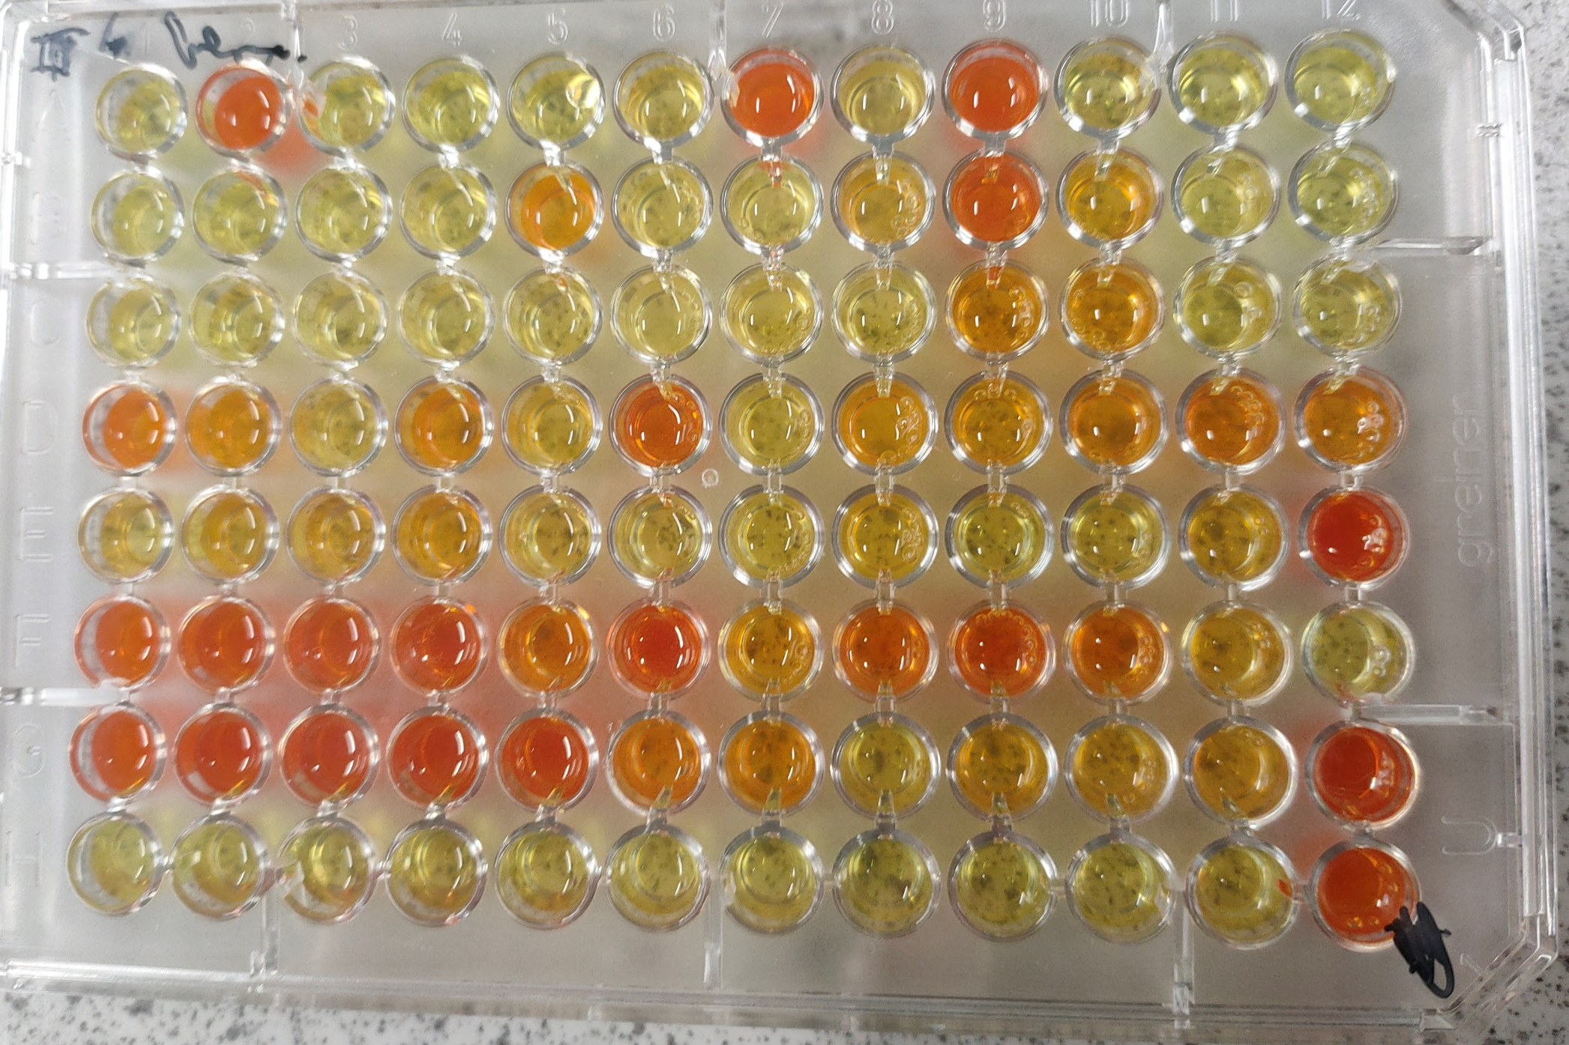
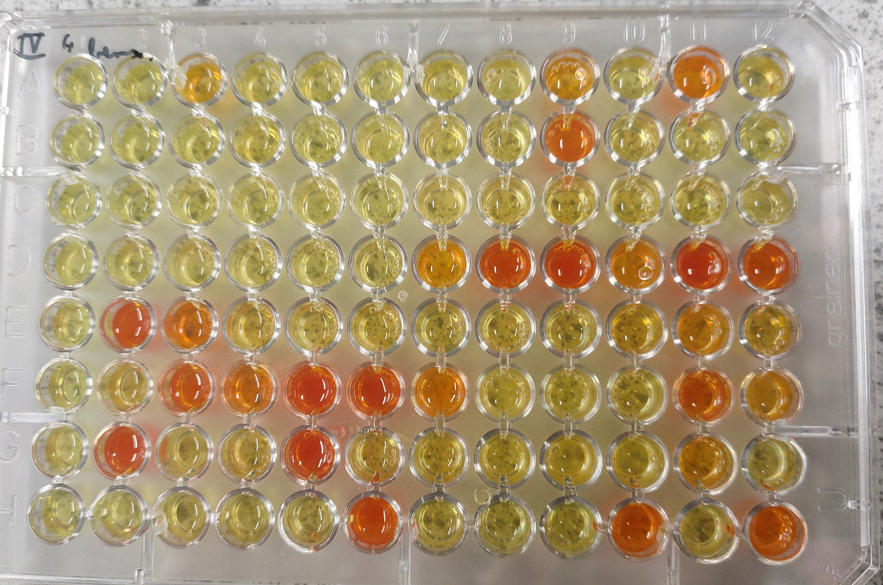
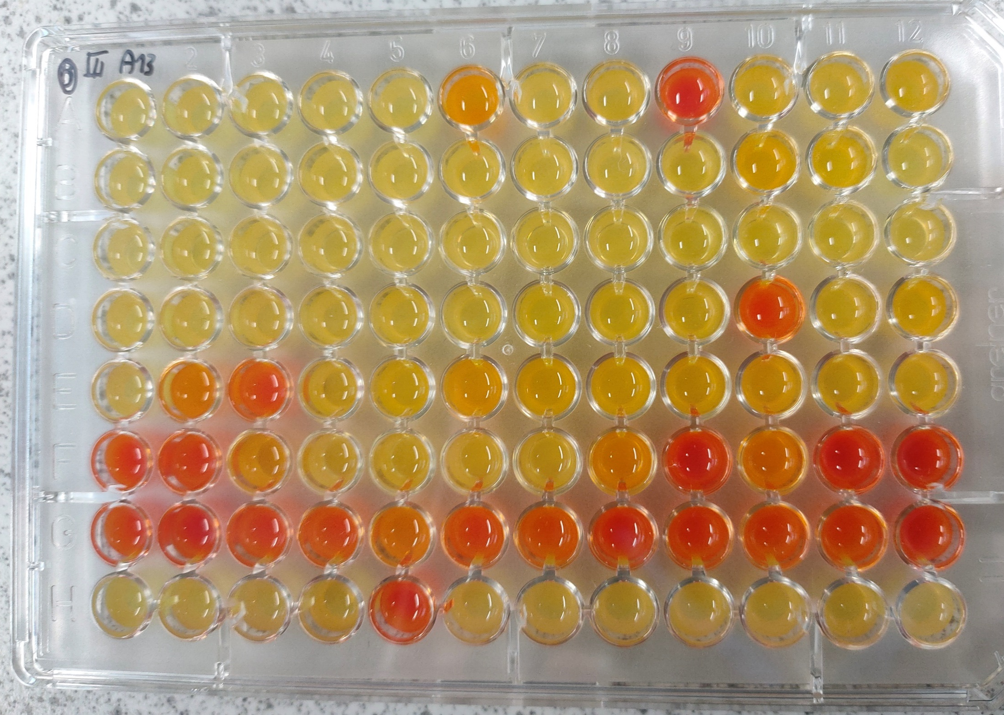
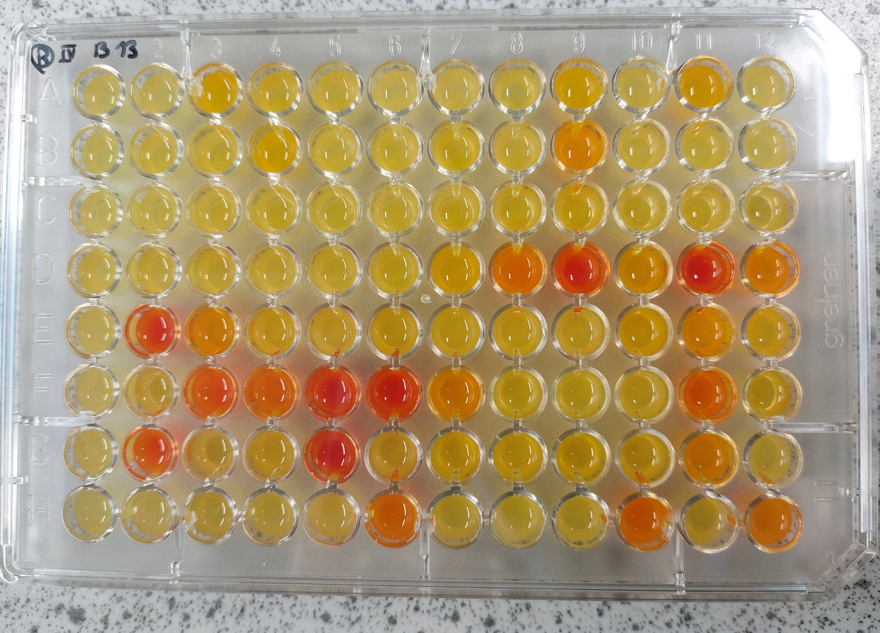
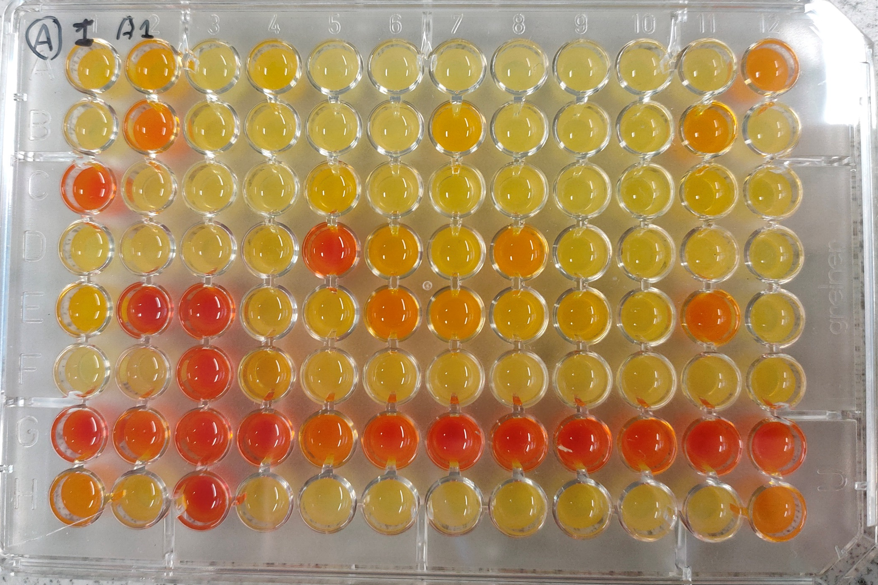
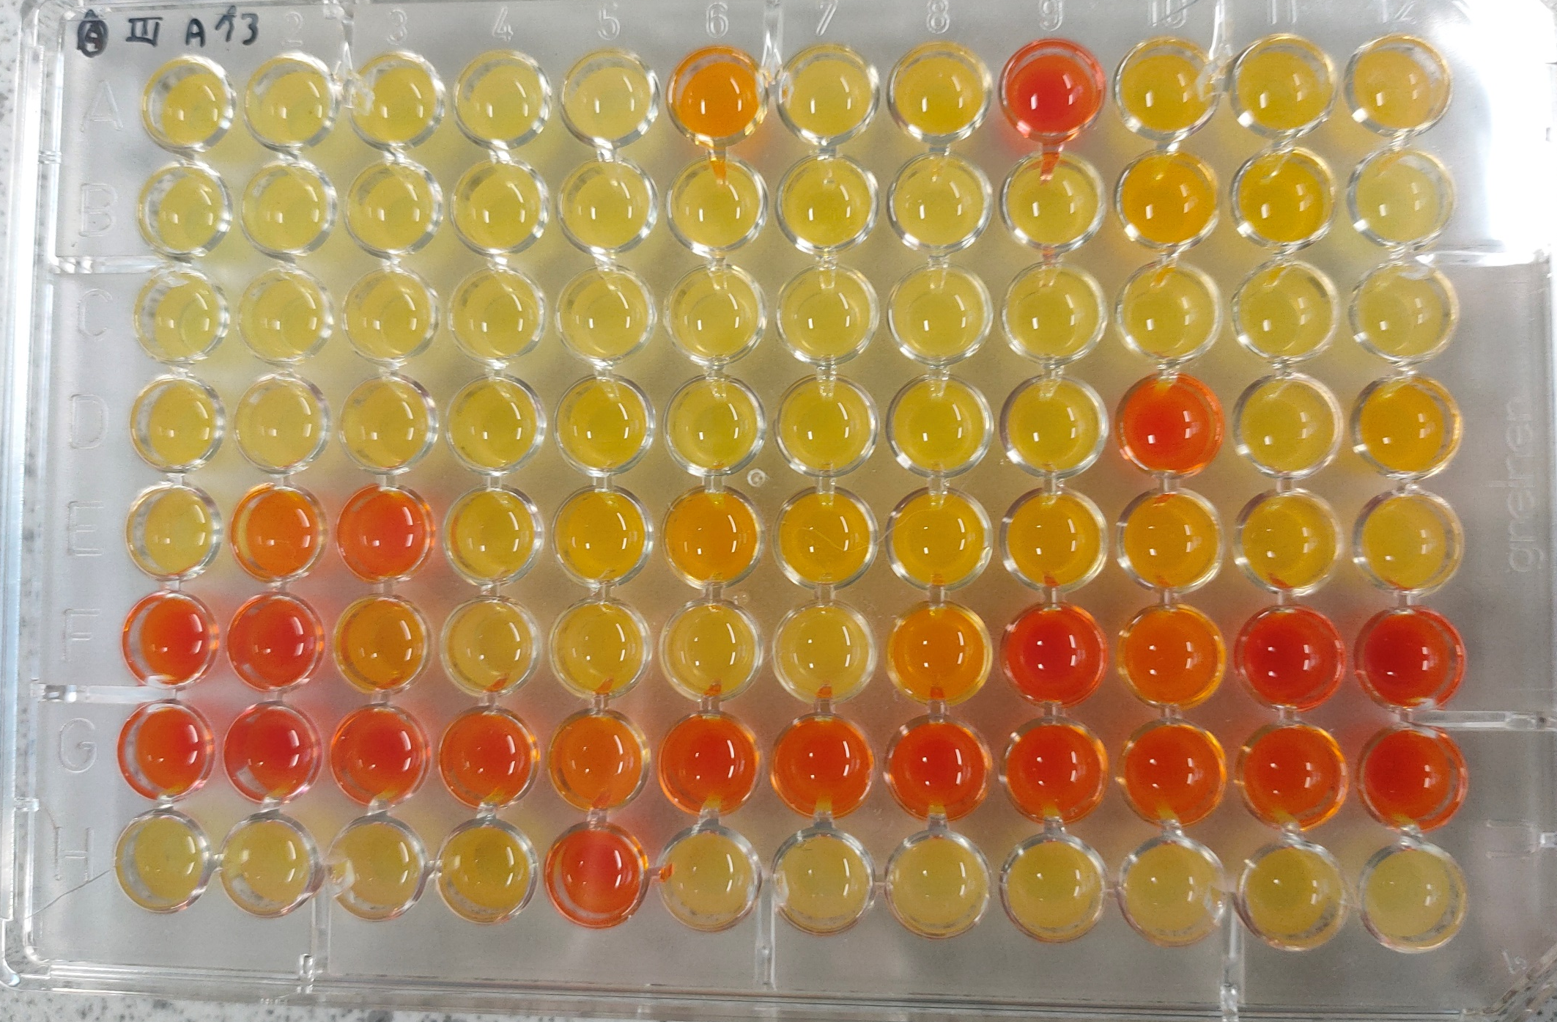
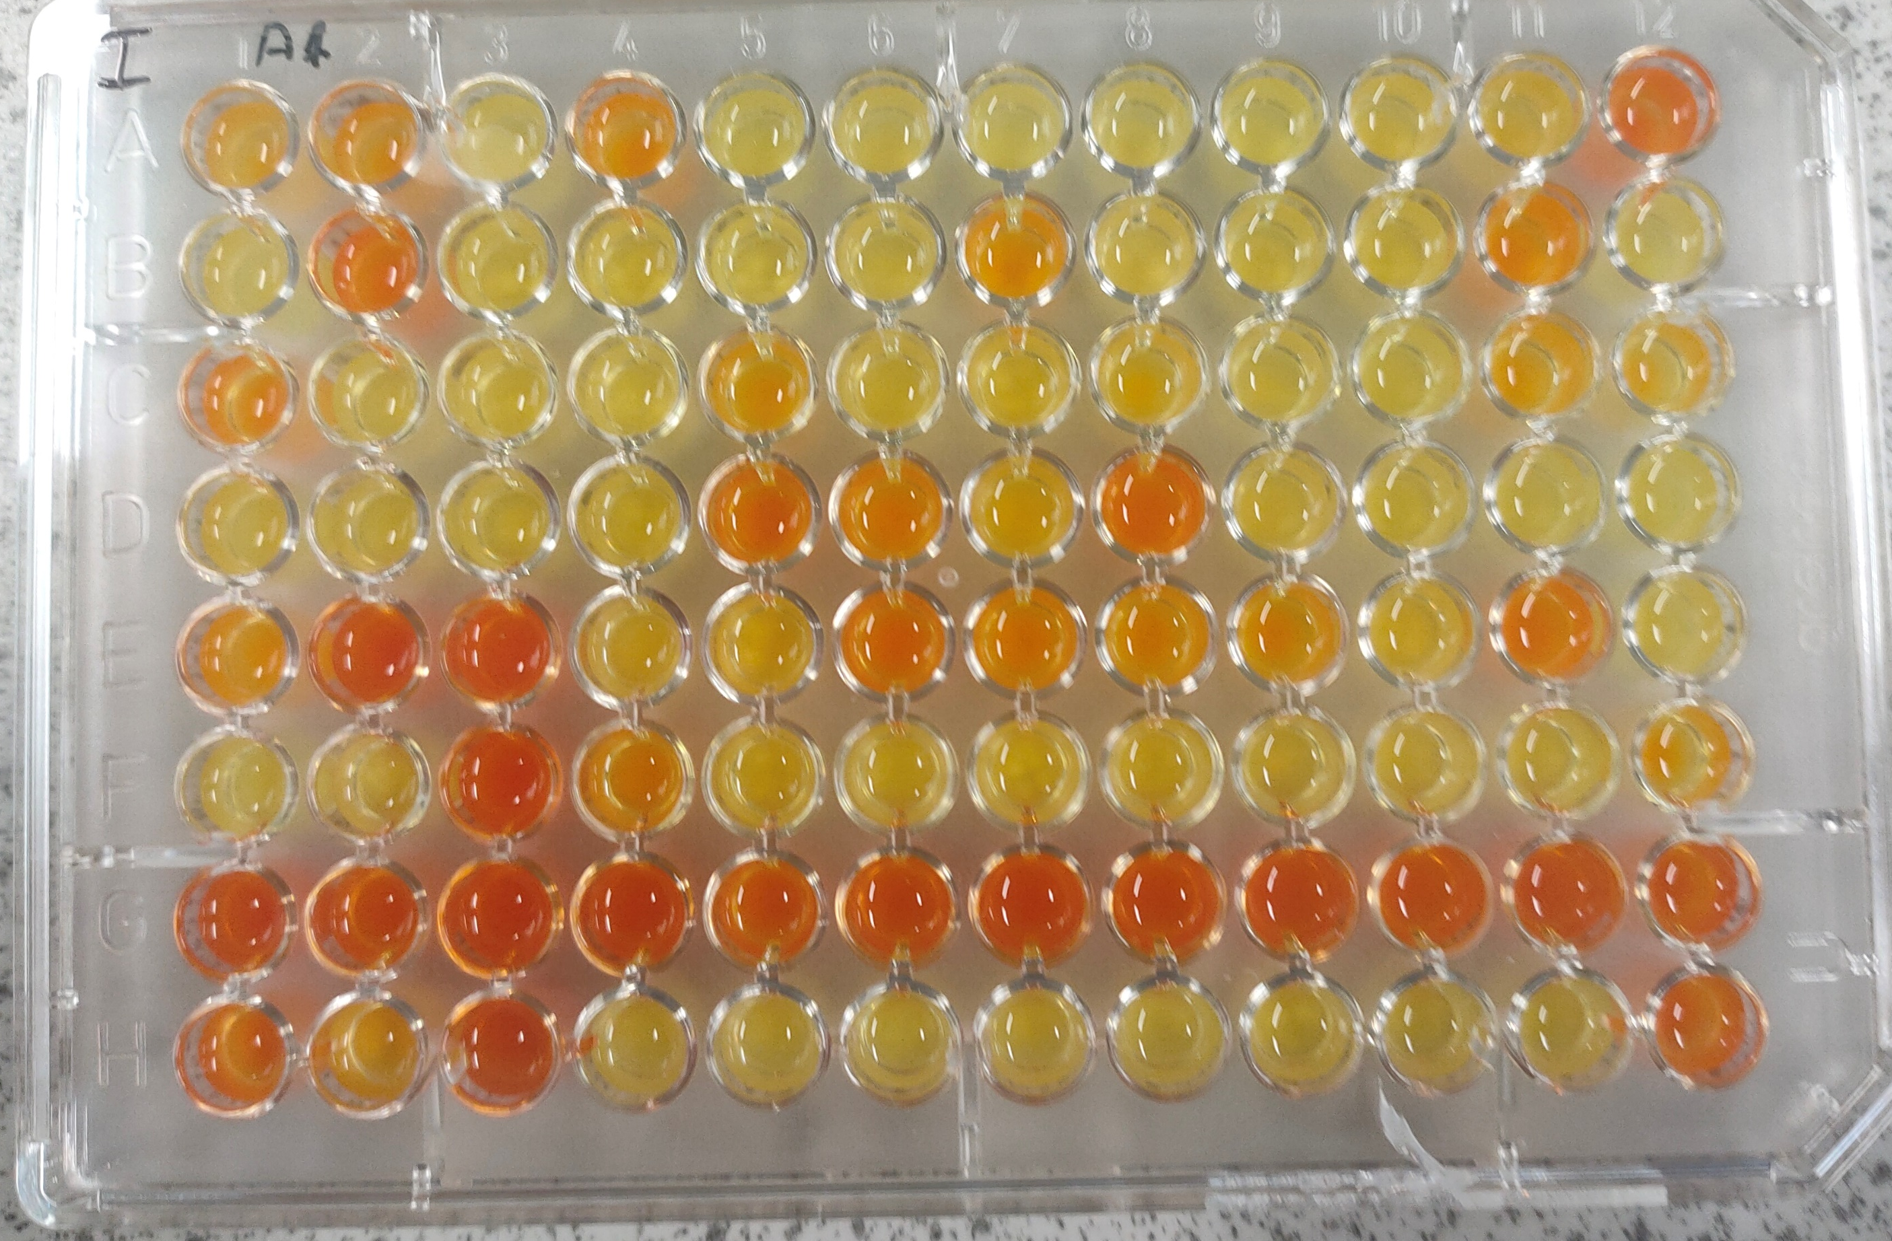
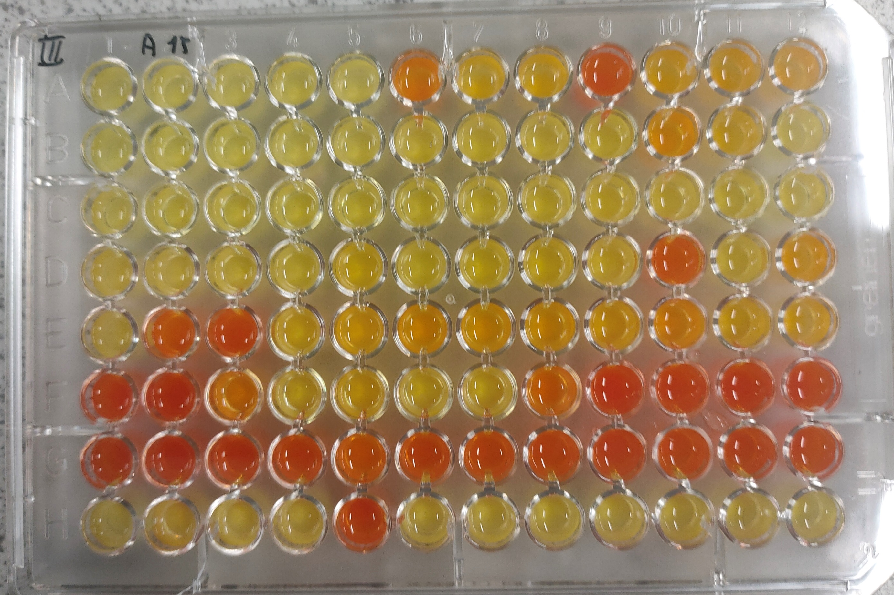
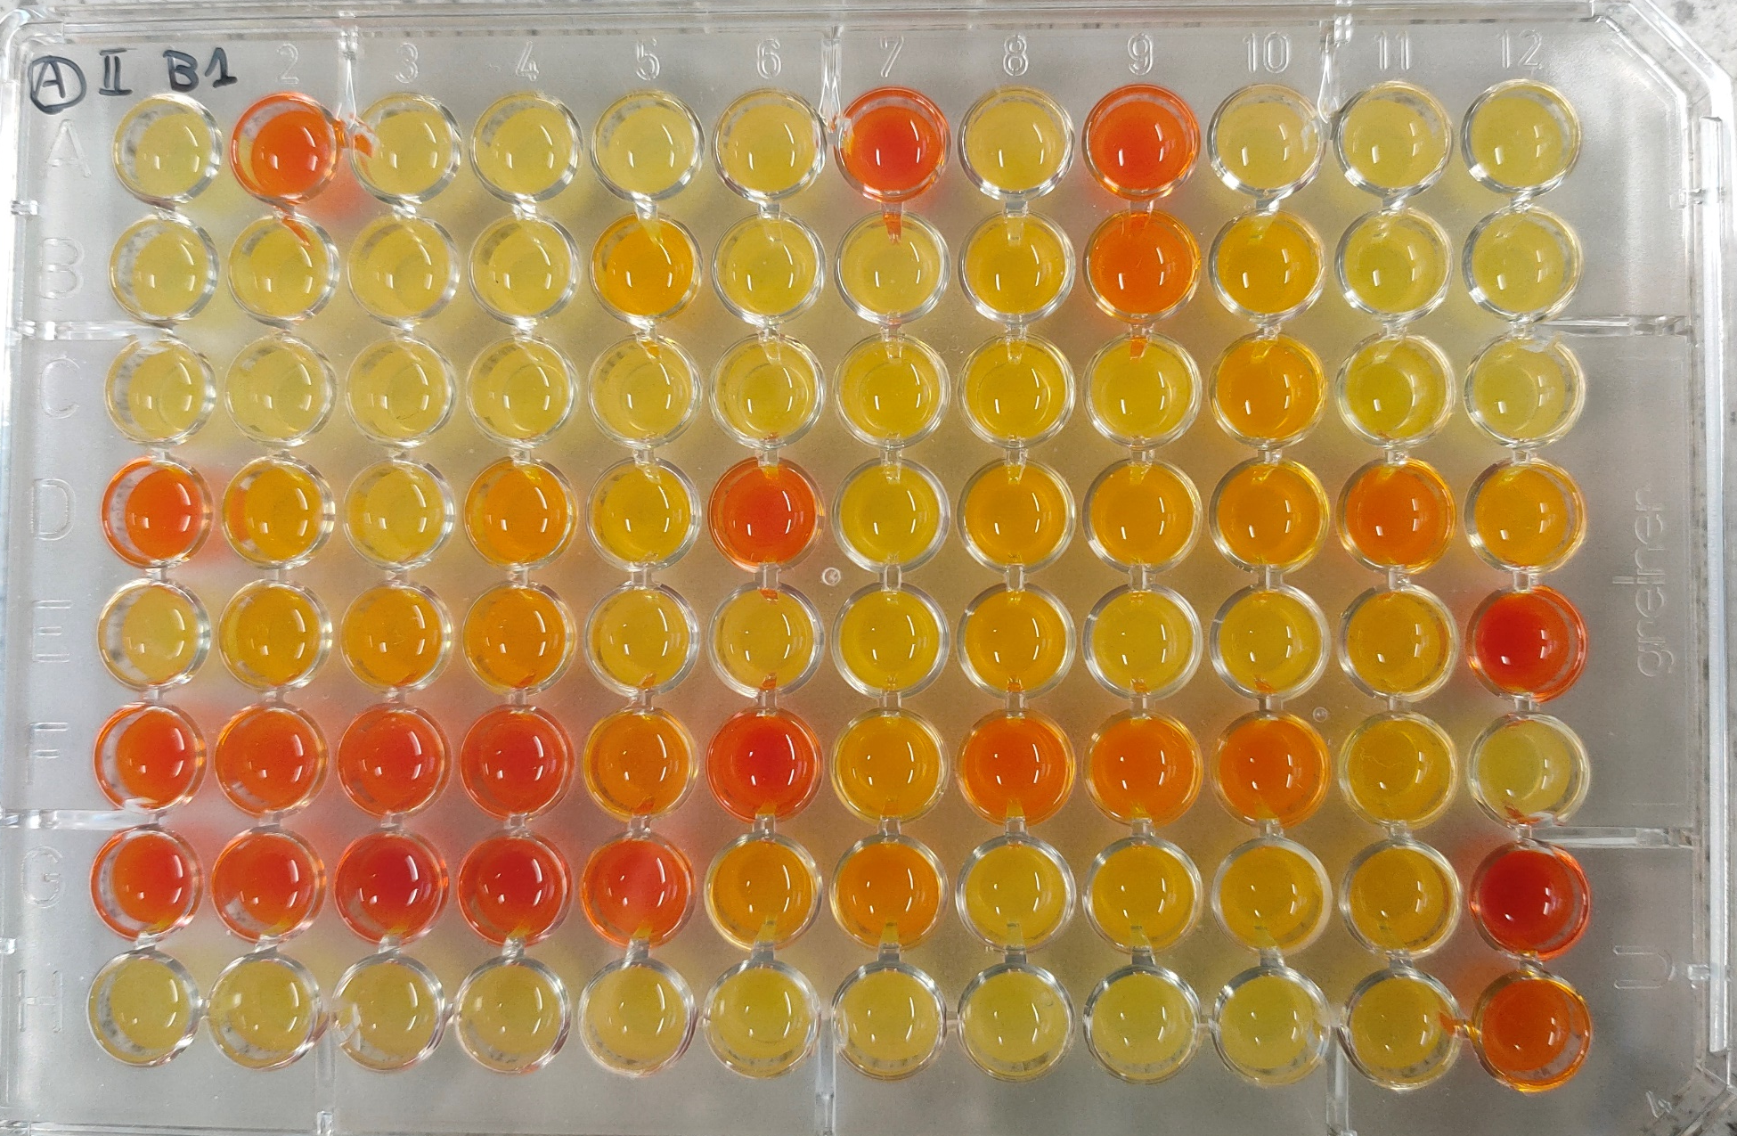
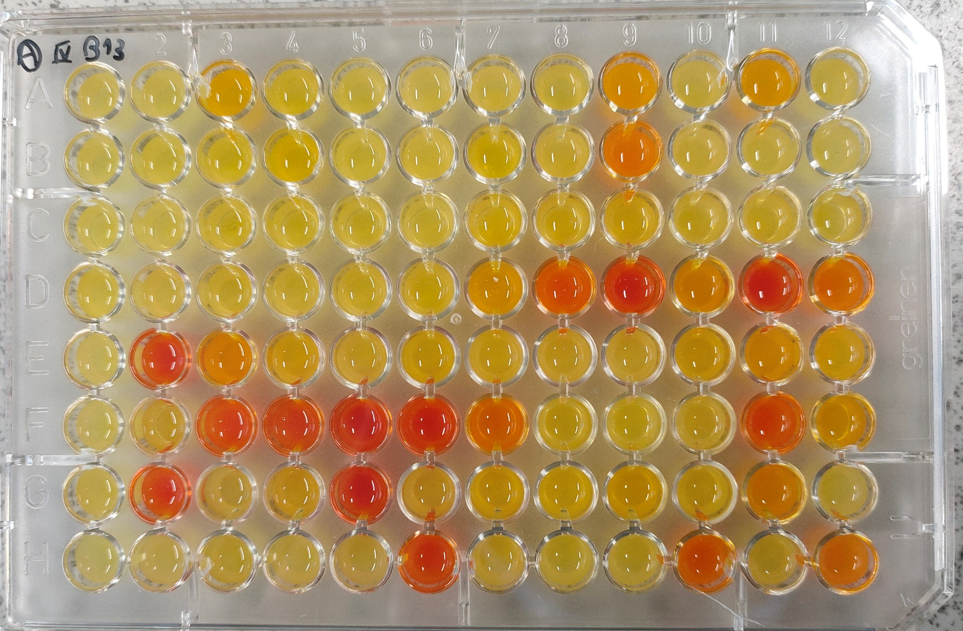
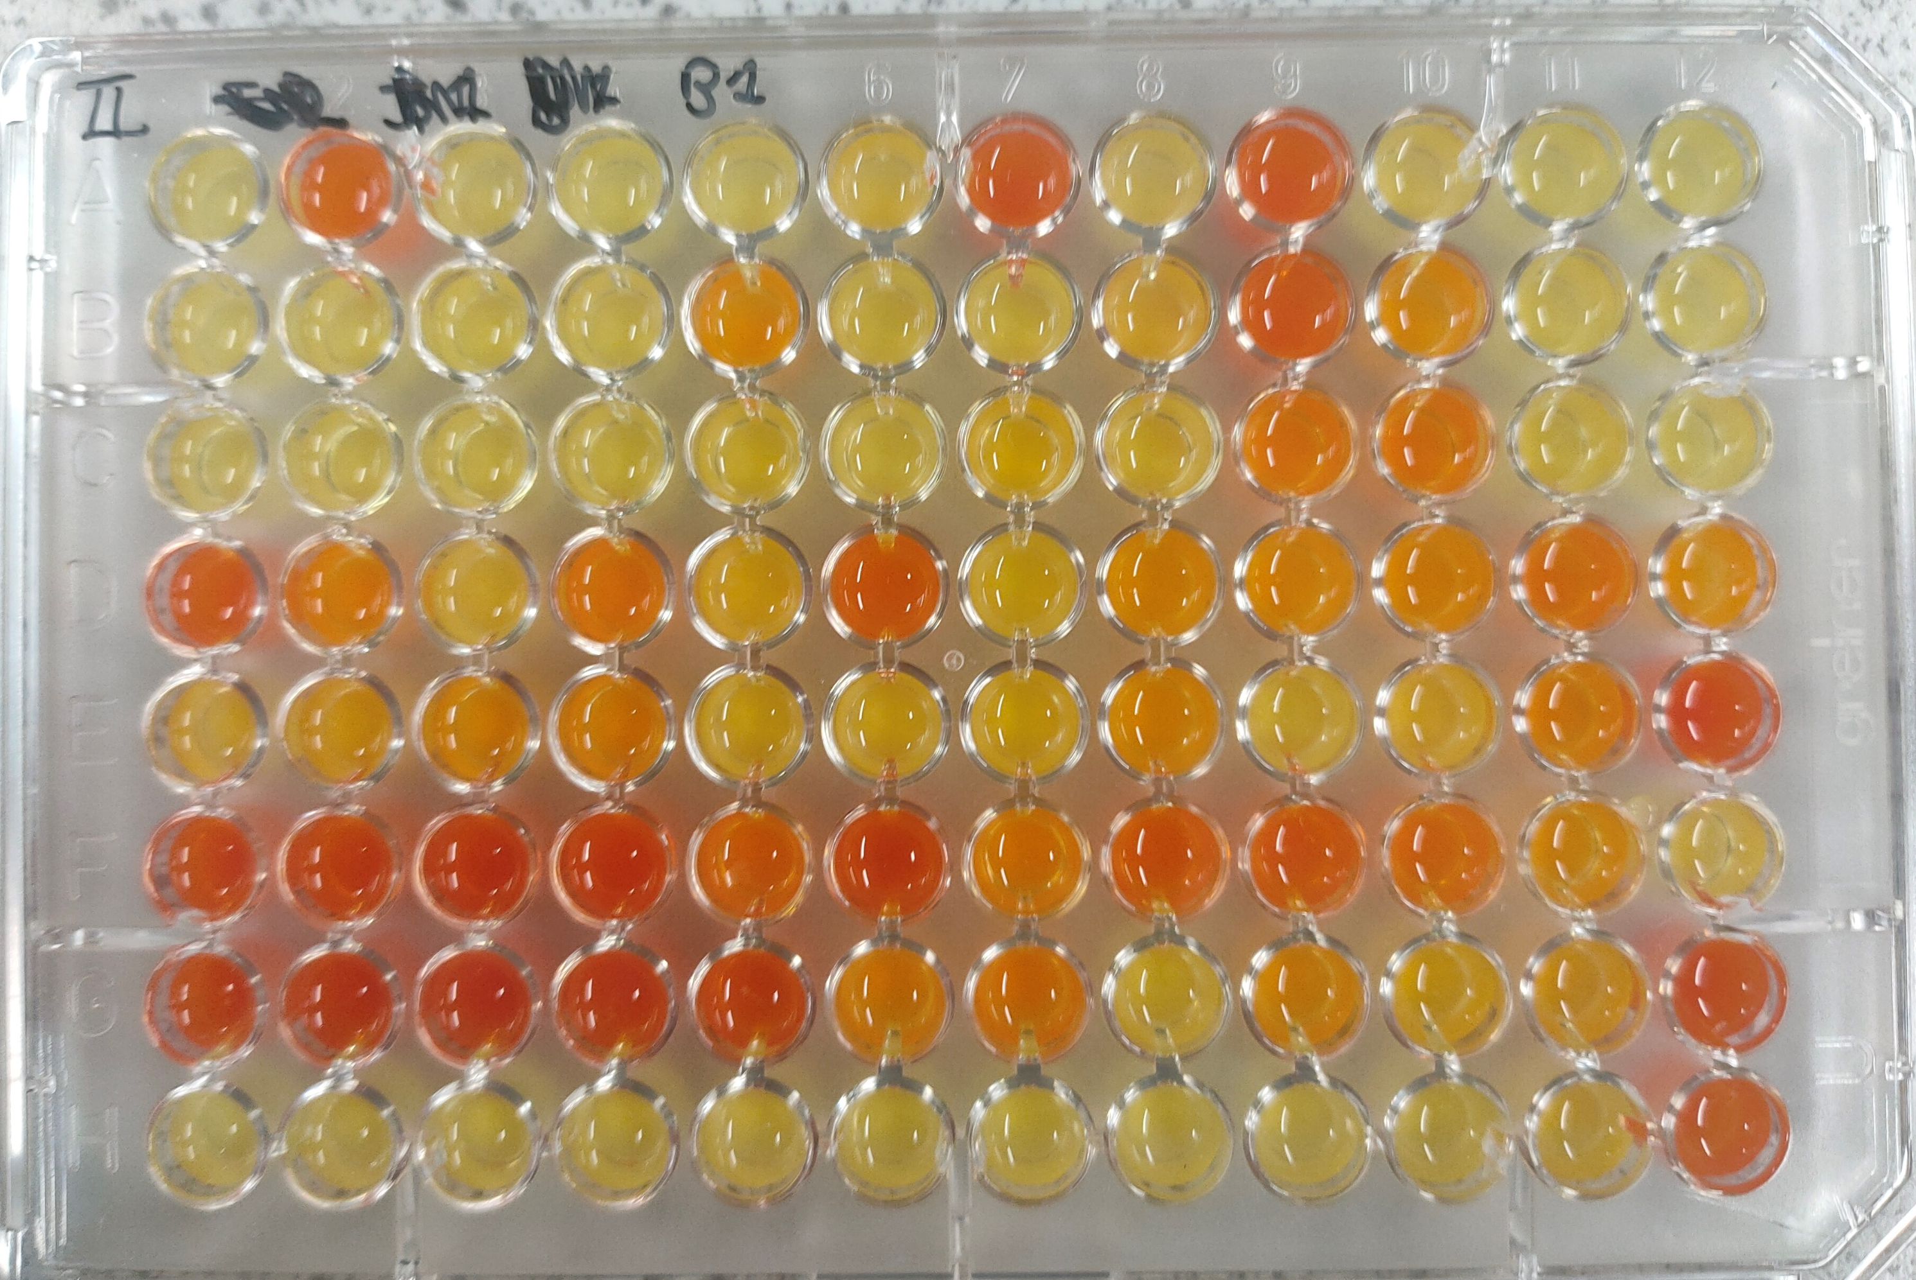
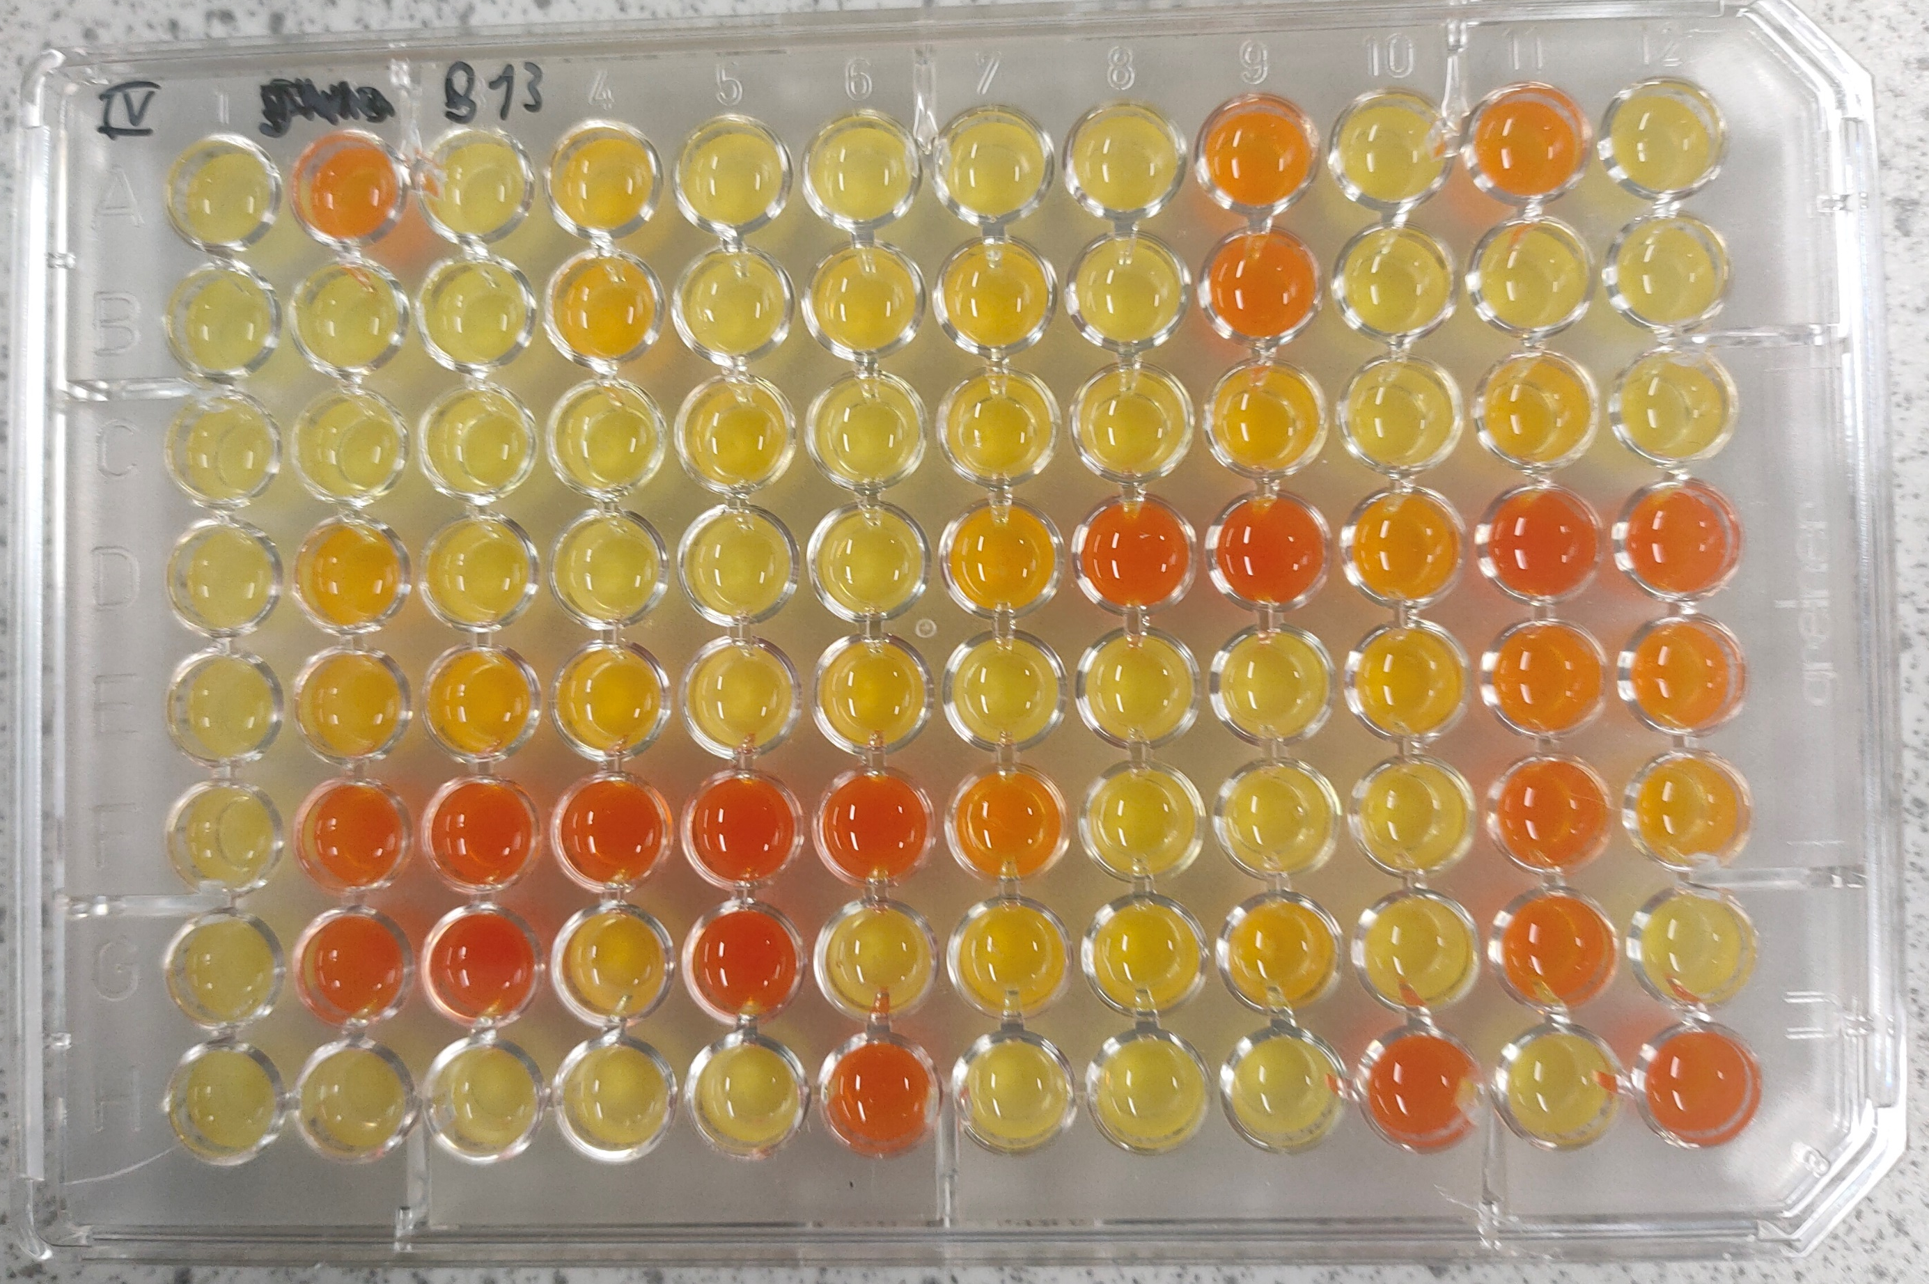
Exploring enzyme biodiversity: paths towards novel biosynthetic routes
D. Baroni¹, S. Gittings², G. J. Poelarends¹
¹ Department of Chemical and Pharmaceutical Biology, University of Groningen, Antonius Deusignlaan 1, 9713 AV Groningen, The Netherlands
² Prozomix, Building 4, West End Ind. Estate, Haltwhistle, UK
Overarching goal
4-OT family of carboligases: a versatile biocatalytic tool
*
Colorimetric screening method to monitor transaminase activity
4-Oxalocrotonate tautomerase (4-OT) has been engineered as a versatile tool for carboligation
Cascade producing amino alcohols, key intermediates for fine chemical as well as pharmaceutical industry
A rapid and sensitive colorimetric screening assay has been employed for determining the activity of a library of 384 highly diverse transaminases produced by Prozomix
Directed evolution of 4-OT, facilitated by available in-plate prescreening methods based on colorimetric turn-on probes yields variants capable of readily accepting aromatic aldehydes for aldol addition and condensation reactions
Selective
Thermostability
Acetaldehyde
3-phenyl butyraldehyde
Active
Benzaldehyde
Engineered 4-OT variants accept aromatic aldehydes and catalyze enantioselective aldol additions
129 TAs showed strong activity towards amination of the aldol addition product analogues and are able to discriminate them from the initial reagents
3-phenyl propanal
Cinnamaldehyde
Directed evolution of 4-OT
Metagenomic library screening
A one pot enzymatic cascade leading to amino alcohols with 4-OT and a selective transaminase is underway
Conclusion
L. Biewenga, M. Crotti, M. Saifuddin, G. J. Poelarends, Selective Colorimetric “Turn-On” Probe for Efficient Engineering of Iminium Biocatalysis. ACS Omega. 5, 2397–2405 (2020).
M. Saifuddin, C. Guo, L. Biewenga, T. Saravanan, S. J. Charnock, G. J. Poelarends, Enantioselective Aldol Addition of Acetaldehyde to Aromatic Aldehydes Catalyzed by Proline-Based Carboligases. ACS Catal. 10, 2522–2527 (2020).
D. Baud, N. Ladkau, T. S. Moody, J. M. Ward, H. C. Hailes, A rapid, sensitive colorimetric assay for the high-throughput screening of transaminases in liquid or solid-phase. Chemical Communications. 51, 17225–17228 (2015).

