Slide 1
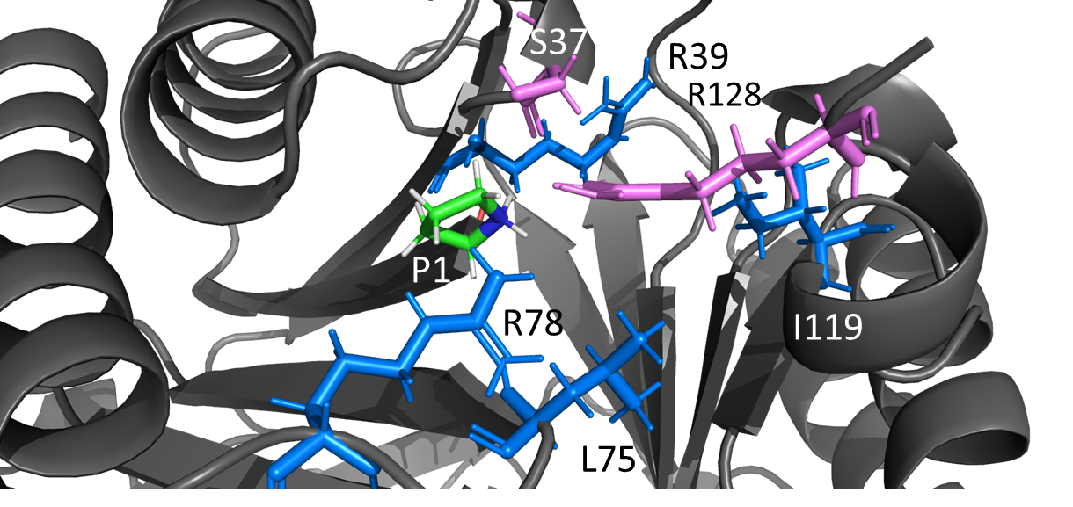
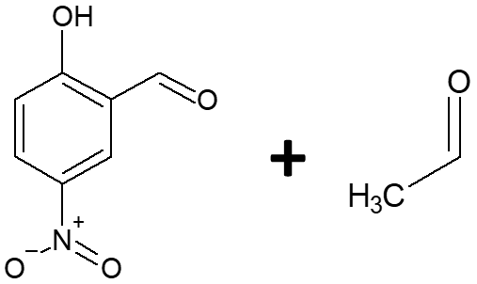
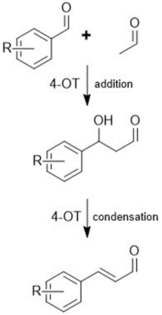
Engineering 4-OT for aldol addition
Objective
Docking analysis
Generate mutants of 4-Oxalochrotonate Tautomerase (4-OT) capable of efficiently catalyzing aldol addition and aldol condensation with benzaldehydes
Oxalocrotonate
Muconate
Why
Convenient, enantioselective route to obtain fine chemicals
Expanding bio-catalytic toolkit
How
NNK libraries (SSM)
Enzyme engineering:
•Engineering depth increased by fusing two chains
•Semi-rational approach + directed evolution
Why 4-OT
Directed evolution campaign (epPCR)
Active towards a wide variety of substrates, including benzaldehydes
62 amino acids, mutability landscapes feasible
Lab progress
3D modelling construction through Alphafold v2.0 and homology modelling
Docking analysis of various possible substrates into 4-OT mutants generated in-silico
Screening method for improved aldol condensation activity optimized
Developing an efficient screening method for the detection of the aldol addition product
First round of enzymatic library generation for the directed evolution via epPCR completed
ACS Omega 2020, 5, 5, 2397–2405
Improving salicylaldehyde probe sensitivity
Needed to detect color changes in fused enzyme variants
Future plans
Optimize screening method
Continue the directed evolution campaign for aldol addition and condensation
Gain insight into which mutations led to more efficient mutants to feed as data for a semi-rational or rational approach

